Slide 1

Pecyn gwaith Bl3 & 4
Tasgau Rhifedd
Year 3 & 4 work pack
Numeracy Tasks

Slide 2

Dewiswch eich siâp / Choose your shape Cofiwch eich colofn / Remember to write your sum as a column! 56
-28
 |  | + | 10
- | 1 | 23 |  | + | 1
 |  | - | 10
 |  | + | 100
- | 10 | 65 |  | + | 10
 |  | - | 100
13 + 6 = | 12 + 16 = | 36 + 35 = | 249 + 35 =
14 - 3 = | 26 + 23 = | 27 + 25 = | 748 - 36 =
21 + 7 = | 37 - 22 = | 28 - 44 = | 466 + 25 =
32 - 2 = | 36 + 32 = | 44 - 36 = | 843 - 17 =
50 + 5 = | 58 - 45 = | 32 - 15 = | 442 - 38 =
75 - 10 = | 22 + 22 = | 36 + 39 = | 264 - 319 =
41 + 7 = | 64 - 14 = | 29 - 37 = | 238 - 646 =
38 - 2 = | 54 - 31 = | 49 + 25 = | 442 + 419 =
52 + 5 = | 48 - 41 = | 38 + 27 = | 362 + 756 =
62 - 7 = | 62 + 52 = | 64 - 37 = | 6421 + 3275 =
 |  | + | 9
- | 11 | 48 |  | + | 11
 |  | - | 9
adio 12 / add 12
35, 47, 59, , , ,
tynnu 8 / subtract 8
12, 20, 28, , , ,

Slide 3



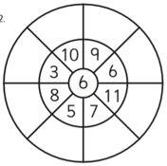
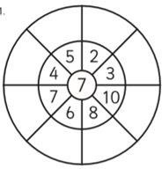


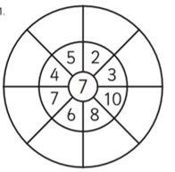



1. Dewiswch eich siâp ac atebwch y cwestiynau
/ Choose your shape and answer the questions.
2. Lluoswch y rhifau / Multiply the numbers
triongl | sgwar |  |  | pentagon
dwbl 9 6 x 2 = dwbl 7 hanner 16 hanner 14 hanner 18 | dwbl 35 hanner 26 dwbl 56 hanner 52 dwbl 33 hanner 48 |  |  | dwbl 358 hanner 686 dwbl 156 hanner 228 dwbl 489 hanner 328
x2
x3
3. Rhannwch y rhifau / Divide the numbers
16 ÷ 4 =
x4

Slide 4

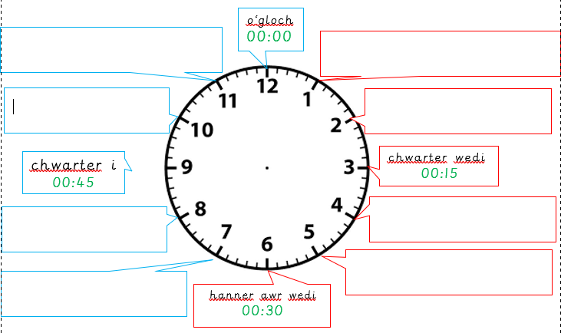
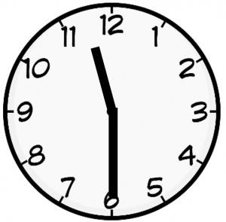
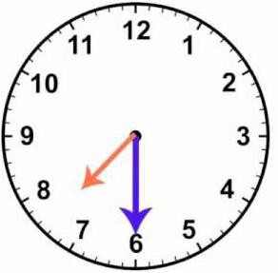
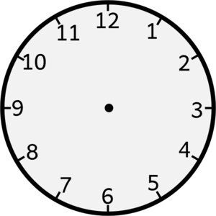


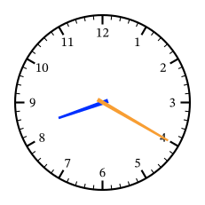
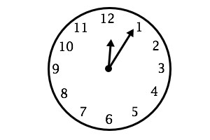

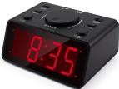
1.Labelwch y cloc / Label the clock
2.Ysgrifennwch yr amser cywir /Write the correct time Her / Challenge: Ysgrifennwch yr amser digidol am y prynhawn / Write the digital time for the afternoon e.e. e.g – 2.30y.b/am – 14:30yp/pm
Geirfa i helpu
munud wedi – minutes past rhifau / numbers:-
Deg munud i naw
munud i – minutes to
Ugain munud i wyth
un – one dau – two | chwech saith – | – six seven | un ar ddeg - eleven deuddeg - twelve
tri – three | wyth – | eight | un deg pump - fifteen
pedwar – four | naw – | nine | dau ddeg / ugain - twenty
pump – five
deg – ten
dau ddeg pump – twenty five
Pum munud wedi deuddeg

Slide 5


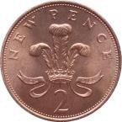
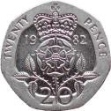
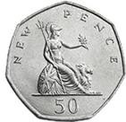
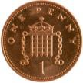



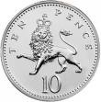
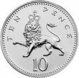

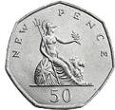
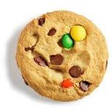

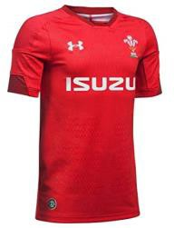






1.Faint o arian? / How much money?
3. Lluniwch y darnau arian cywir / Draw the correct money pieces
=
=
=
=
nge. id o £1 | Cyfanswm / Amount | Lleiaf o ddarnau / Least amount of pieces | Ffordd arall / Different way
 | 37c
 | 74c
 | 92c
 | £1.25
 | £1.94
 | £2.99
 | £5.12
newid o £2 =
 | £10.20
2.Gweithiwch allan y newid. / Work out the cha
new
=
newid o £1
=
newid o £1
=
newid o £2
=
newid o £2
=

Slide 6


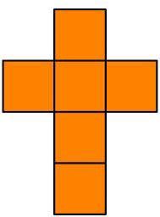
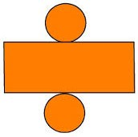
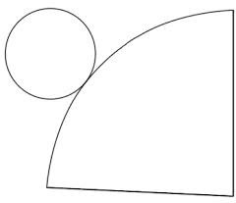
1.Dosbarthwch y siapiau. / Distribute the shapes.
 | Pedwar neu fwy o gorneli / four or more corners | Llai na pedwar cornel / less than 4 corners
Pedwar neu fwy o ochrau four or more sides
Llai na pedwar ochr Less than four sides
2.Rhwydi pa siapiau 3D yw’r rhain? / The nets for which 3D shape are these?

Slide 7


1.Trosglwyddo’r data i graff bar / Transfer the data to a bar chart.
ffrwyth | nifer o blant
ceirios | IIII IIII IIII III
afal | IIII IIII IIII
banana | IIII
oren | IIII IIII I
grawnwin | IIII
nifer o blant
2.Atebwch y cwestiynau canlynol / Answer the following questions.
ffrwyth
nofio / swimming
rygbi / rugby
gymnasteg /gymnastics
pêl-droed / football
Allwedd / Key:-
Faint o blant sy’n hoffi nofio?
How many children like swimming?
Faint o blant sy’n hoffi gymnasteg?
How many children like gymnastics?
= 4 o blant
/children
3.Mae mwy o blant yn dewis rygbi na phêl-droed, faint yn fwy?
More children choose rugby over football, how many more?

