Slide 1
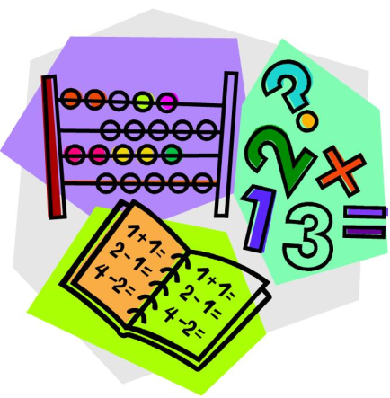

Croeso
Welcome
Bore Mathemateg

Slide 2
Thank you for giving up your time!
Research shows that it’s your participation and engagement that ensures your child’s success

Slide 3
‘Parental involvement in children’s education from an early age has a significant effect on educational achievement, and continues to do so into adolescence and adulthood.’
“ In the early years, parental involvement has a significant impact on children’s cognitive development and literacy and number skills.”

Slide 4
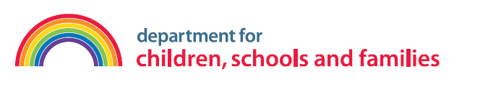
‘What parents do is more important than who they are for children’s early development – i.e. home learning activities undertaken by parents is more important for children’s intellectual and social development than parental occupation, education or income.’
The Impact of Parental Involvement on Children’s Education
Department for Children, School and Families

Slide 5
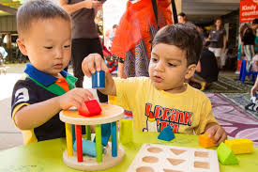
Play is the natural way in which children learn.
“Play is an effective vehicle for fostering Mathematical concepts and developing positive attitudes to mathematics.”
Maths is everywhere in the home. With the support of parents, children can grasp many mathematical concepts through their play.

Slide 6
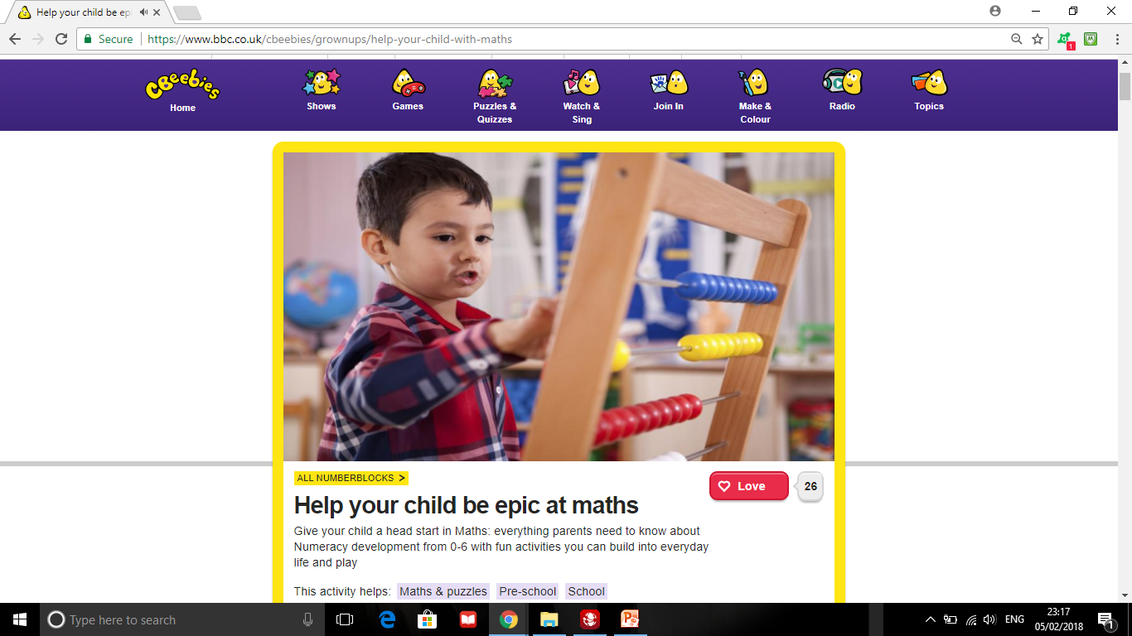

Slide 7
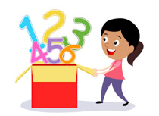
Children will begin to:
• know and understand early maths language of measurement, shapes, spaces, positions, early
numbers, order and patterns
• know the sequence of numbers
• begin to understand positional words, e.g. in, on, outside
• show an awareness of time
• be aware of shapes in their environment
• be aware of 1-to-1 correspondence
• acquire new vocabulary, e.g. big, small, heavy light, empty, full etc.
• learn number rhymes and songs, e.g. one, two, buckle my shoe etc.
• be aware of number conservation

Slide 8
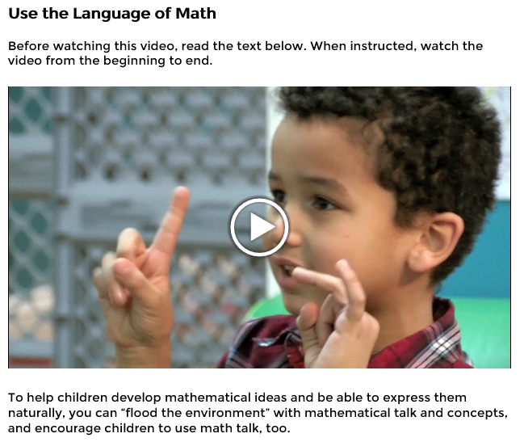

Slide 9
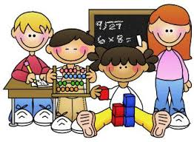
How children learn about numbers and develop mathematical understanding during the early years is vitally important and sets them on a path towards numeracy skills and confidence in later life.

Slide 10


What is expected of Nursery / Reception/Year 1 Children?

Slide 11
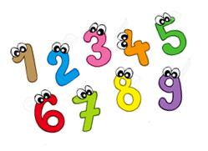
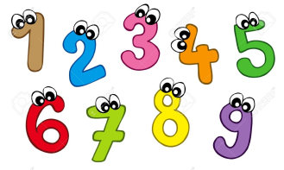
Counting and Numbers
Nursery | Reception | Year 1
Recite numbers from 0-10, forwards and backwards starting from different numbers | Recite numbers up to 20 forwards and backwards from different starting points | Recite numbers up to 100 forwards and backwards and from different starting points
Recognise numbers from 0-5 | Read and write numbers to at least 10 | Read and write numbers to at least 20 forming and orientating them correctly

Slide 12
Counting and Numbers
Nursery | Reception | Year 1
Count reliably up to 5 objects | Count reliably up to 10 objects | Count reliably up to 20 objects
Secure number conservation from 0-5 | Secure number conservation 0-10 | Secure number conservation 0-20

Slide 13
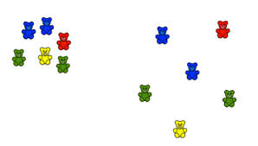
Counting and Numbers
Number conservation……….

Slide 14
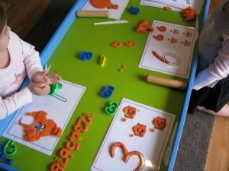
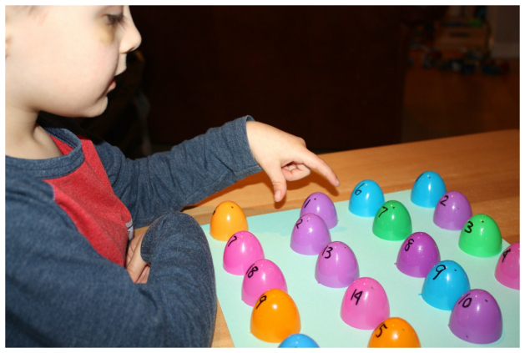
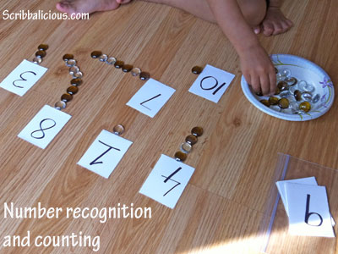
Counting and Numbers

Slide 15
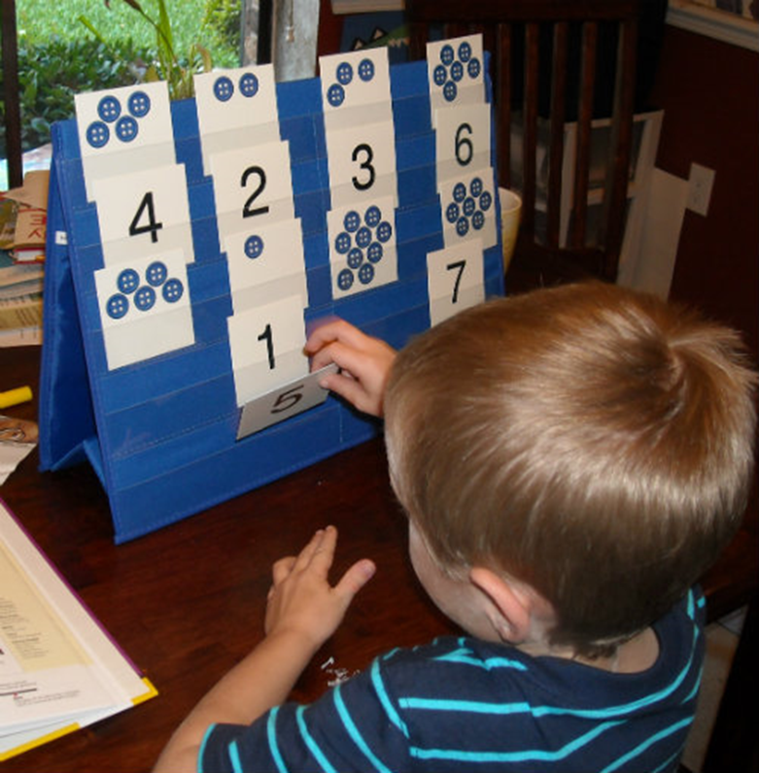
Counting and Numbers

Slide 16
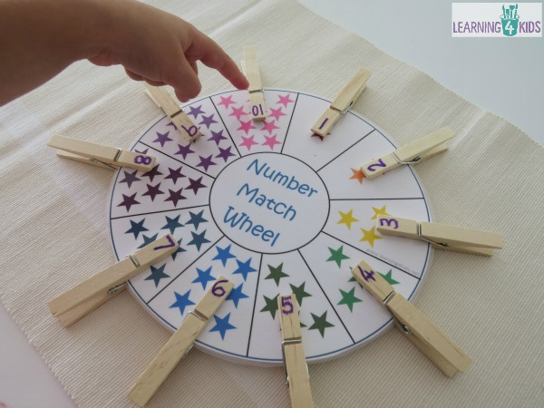
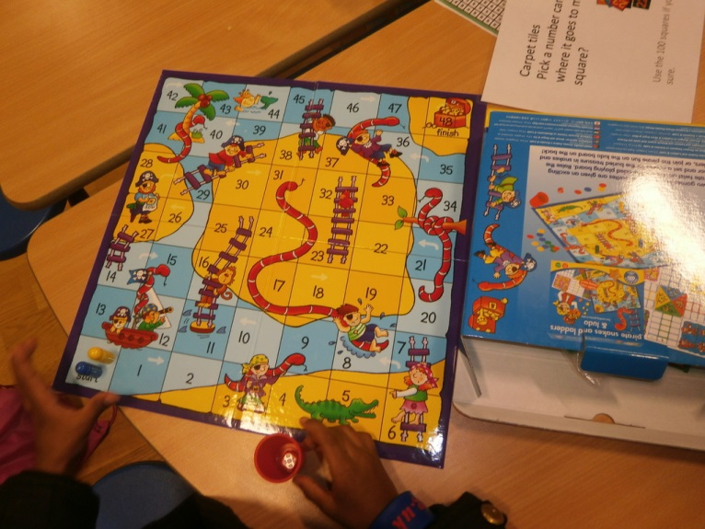
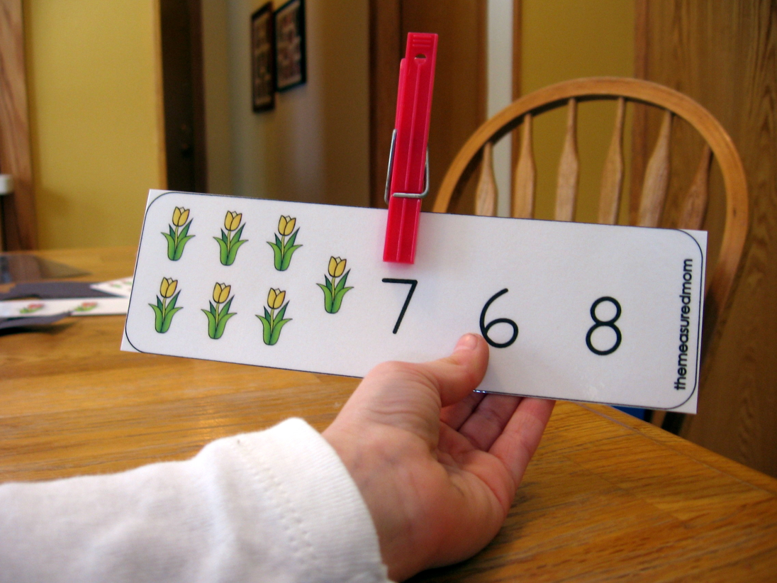

Slide 17
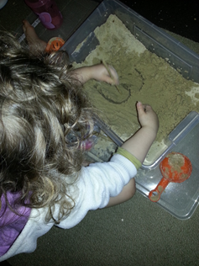
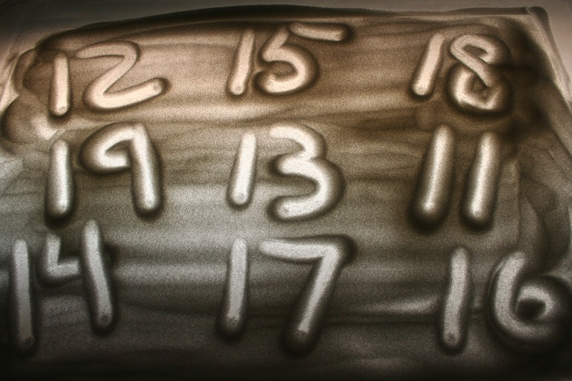
Counting and Numbers

Slide 18
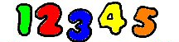
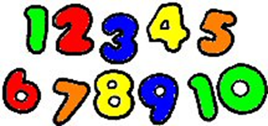
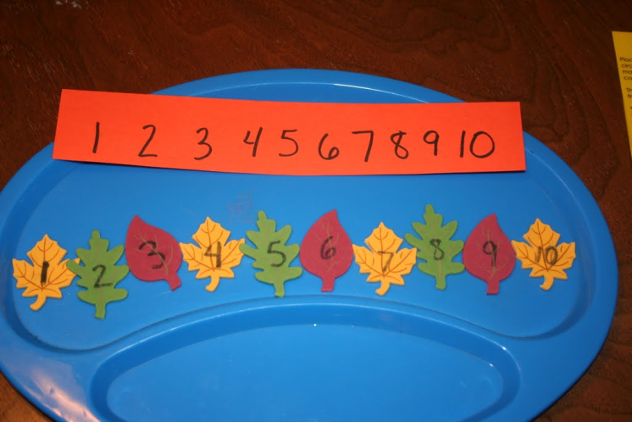
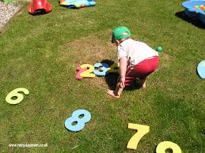
Counting and Numbers
Nursery | Reception | Year 1
Compare and order numbers up to 5 | Compare and order numbers up to 10 | Compare and order numbers up to at least 20

Slide 19
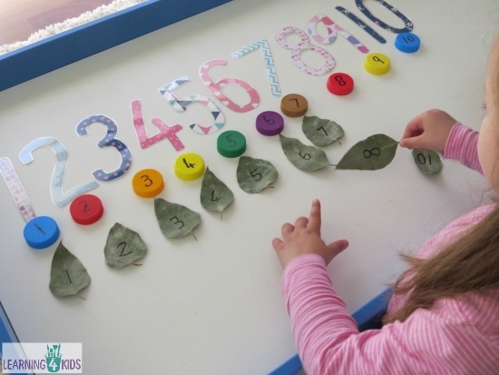

Slide 20
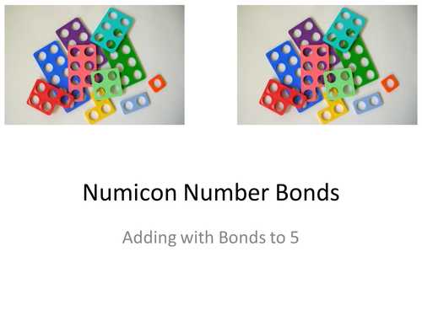
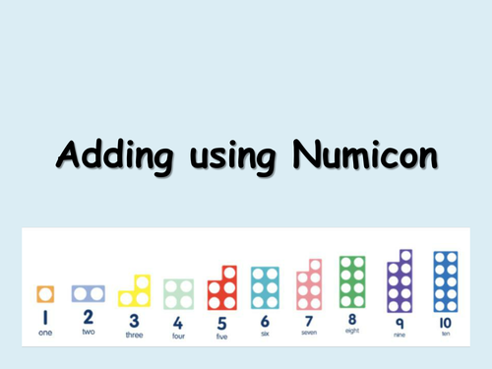
Counting and Numbers
Numicon

Slide 21
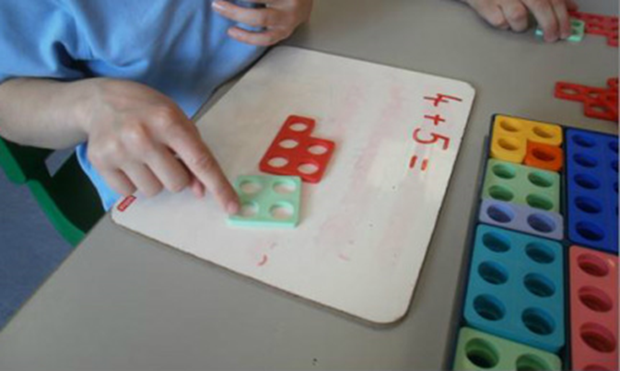
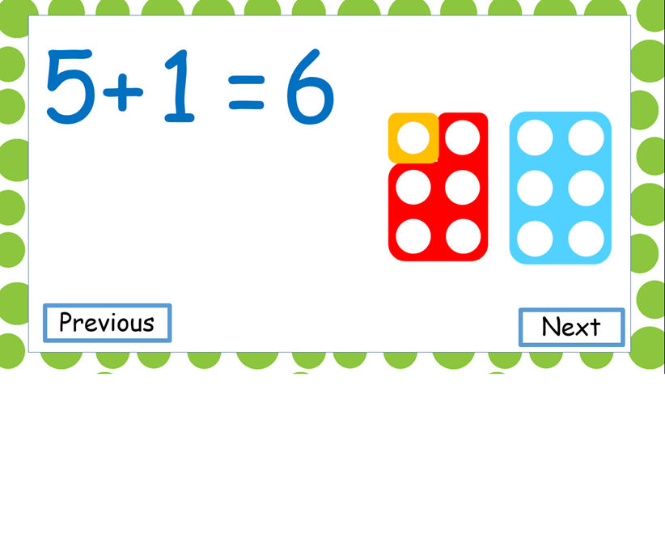
Counting and Numbers
Nursery | Reception | Year 1
 | Combine two groups of objects to find ‘how many altogether’ (addition) | use ‘counting on’ strategies to add two collections, starting with the larger number, e.g. 8 + 5

Slide 22
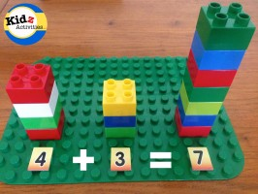
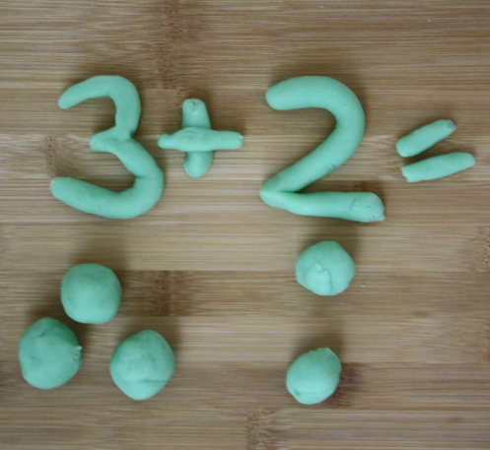
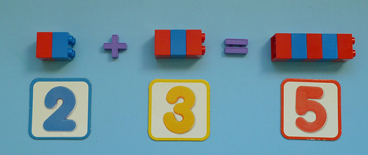
Counting and Numbers

Slide 23
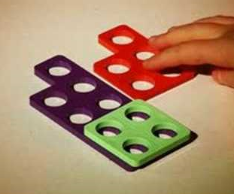
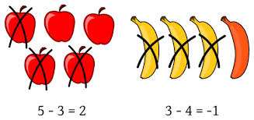
Counting and Numbers
Nursery | Reception | Year 1
 | Take away objects to find out how many are left (subtraction) | add and subtract numbers involving up to 10 objects

Slide 24

Counting and Numbers
Nursery | Reception | Year 1
 | Solve simple problems in a practical situation that involve simple addition and subtraction up to 5 | solve one-step problems that involve addition and subtraction, including missing number problems, e.g. 7 + _ = 9, using concrete objects and pictorial representations

Slide 25



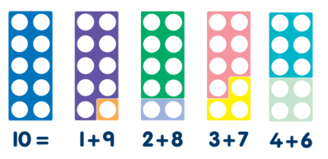
Counting and Numbers
Nursery | Reception | Year 1
 | Use number facts to 5 | use number facts within 10, i.e.: – doubling and halving, e.g. 4 + 4 – bonds of 10, e.g. 6 + 4
Number Bonds
Number Facts

Slide 26
Counting and Numbers
Nursery | Reception | Year 1
 | Count in 2’s to 10 0,2,4,6,8,10 | Count in 2’s to 100
 | Count in 10’s to 100 0,10,20,30,40,50,60,70,80,90,100! | Count in 5’s and 10’s to 100 0, 5, 10, 15, 25, 30… etc

Slide 27
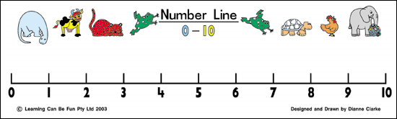
Counting and Numbers
Nursery | Reception | Year 1
Understand the concept of ‘one more’ and ‘one less’ in their play. ‘un arall/ un yn fwy, un yn llai’ | Mentally recall one more / one less of a number within 10 | Mentally recall one more / one less of a number within 20

Slide 28
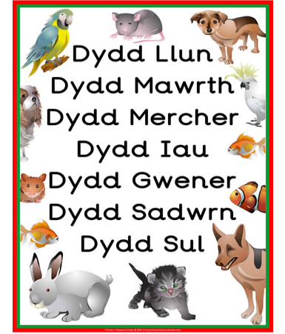
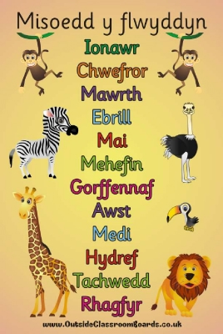
Counting and Numbers
Nursery | Reception | Year 1
Sing / chant days of the week | Sing / chant days of the week and months of the year | Understand and order the days of the week, the months and seasons of the year in meaningful contexts

Slide 29
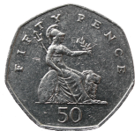
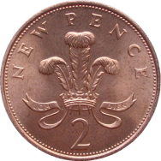
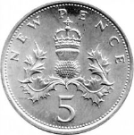
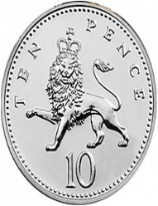

Money
Nursery | Reception | Year 1
Use coins in role play | Use 1p, 2p 5p and 10p coins to pay for items | Use different combinations of money to pay for items up to 20p Find totals and give change from 10p

Slide 30
Shape
Nursery | Reception | Year 1
Recognise and use the names for 2D shapes | Recognise and name common 2D and 3D shapes | Recognise and name common 2D shapes and 3D shapes in order to begin to compare and sort

Slide 31
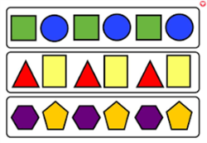
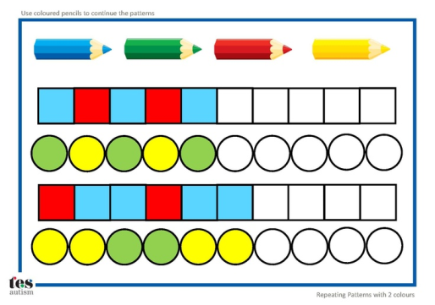
Shape
Nursery | Reception | Year 1
Copy a range of simple patterns and sequences visually and aurally e.g. clapped patterns threading activities | Recognise and repeat three object / clapped patterns and sequences | Demonstrate an understanding of repeating patterns, including shape and number, by describing, reproducing and extending

Slide 32
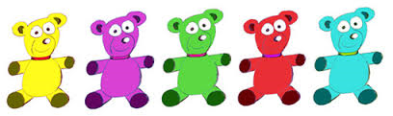
Ordinal Language
Nursery | Reception | Year 1
Use terms 1st, 2nd, 3rdin their play (in Welsh) 1af, 2ail, 3ydd | Use ordinal numbers up to 10 | Use ordinal numbers to 20 in practical situations
1af
2ail
3ydd
4ydd
5ed

Slide 33
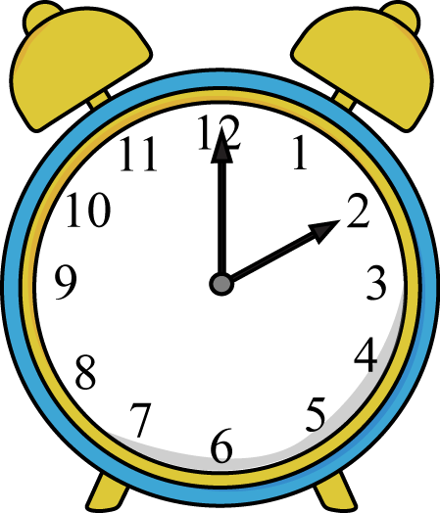
Time
Nursery | Reception | Year 1
 | Demonstrate a developing sense of how long tasks and everyday events take | Use standard units of time to read ‘o’clock’ using both analogue and 12-hour digital clocks

Slide 34
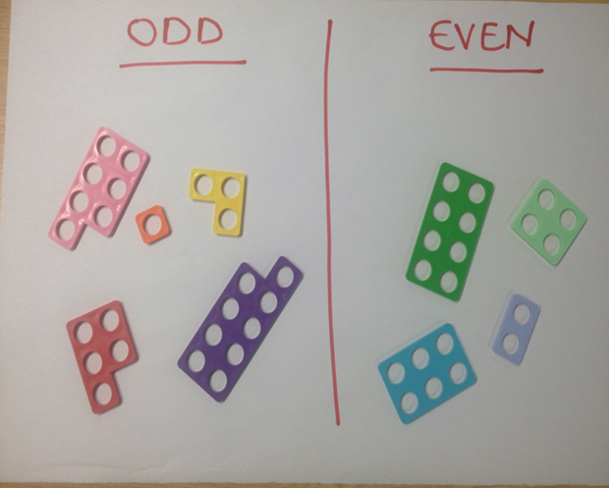
Odd and Even Numbers
Year 1 | Year 2
Recognise odd and even numbers up to 20 | Recognise odd and even numbers up to 100

Slide 35

Odd and Even Numbers
Year 2 - Challenge
Identify odd and even numbers to a 1000

Slide 36
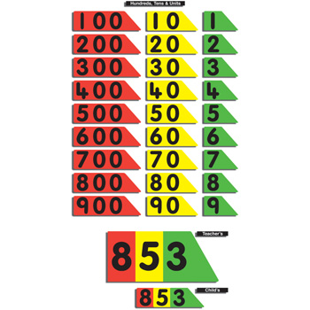
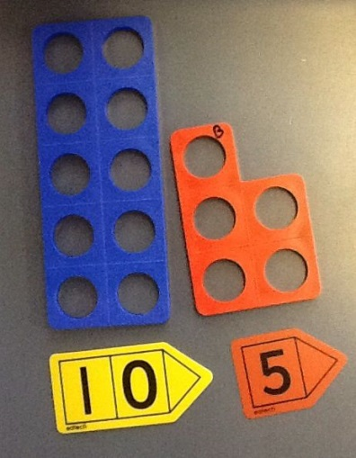
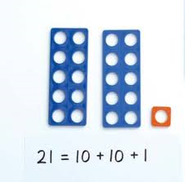
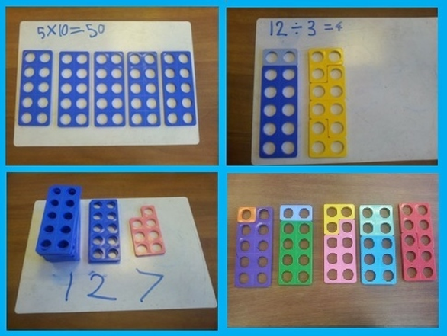
Place Value
Year 1 | Year 2
Demonstrate an understanding of place value e.g one 10 and four units equal 14, up to at least 20 | Demonstrate an understanding of place value to at least up to 100.

Slide 37
Place Value
Year 2 - Challenge
Demonstrate and understanding of place value to a 1000

Slide 38

7
3
Let’s partition 73 into seventy and three.
3
7
0
Seventy
Three

Slide 39


Counting and Numbers
Year 1 | Year 2
Use ‘counting on’ strategies to add two collections, starting with the larger number e.g. 8 + 5 | Use ‘counting on’ strategies to add two collections, starting with the larger number e.g. 38 + 7 Use ‘counting back’ strategies to take away

Slide 40
Mental Recall
Year 1 | Year 2
Mentally recall one more / one less of a numbers to 20 | Mentally add 10 and 20 to a given number up to 100 23 +20, 20 + 13 Also subtract ….

Slide 41
Counting and Numbers
Year 1 | Year 2
Solve simple problems in a practical situation that involve simple addition and subtraction up to at least 10 | Solve one and two step problems that involve addition and subtraction, multiplication and division

Slide 42


Slide 43





Big Maths
At
Ysgol Gymraeg Caerffili

Slide 44


Why Big Maths?
Clear progression from year to year
Common methods taught and language used throughout the school
Build on prior learning and ensure children are secure in their knowledge
Objectives are clearly matched to National Curriculum objectives
Improve mental maths skills and general numeracy across the school

Slide 45
What is CLIC?
The four elements of CLIC are:
Counting
Learn Its
It’s Nothing New
Calculation

Slide 46


Slide 47


Slide 48

Learn Its
1+1=2
Counting in multiples of 2,5 & 10
2+2=4
3+3=6
4+4=8
2+3=5
5+5=10
2+1=3

Slide 49
How to help your child at home
Practise counting backwards – starting at different points
Form numbers correctly
Recognise numbers in Welsh– especially tens and units
Please where possible, always encourage your child to say them in Welsh

Slide 50
Thank you for coming!
Any questions?

Slide 51
Useful links https://www.bigmaths.com https://www.ysgolgymraegcaerffili.co.uk/cymorth-rhifedd-numeracy-support https://corbettmathsprimary.com/5-a-day/ https://hwb.gov.wales/curriculum-for-wales/mathematics-and-numeracy/

