Slide 1


Croeso
Welcome
Bore Mathemateg
Blwyddyn 2

Slide 2


Questionnaire

Slide 3
Thank you for giving up your time!
Research shows that it’s your participation and engagement that ensures your child’s success

Slide 4
‘Parental involvement in children’s education from an early age has a significant effect on educational achievement, and continues to do so into adolescence and adulthood.’
“ In the early years, parental involvement has a significant impact on children’s cognitive development and literacy and number skills”

Slide 5

‘What parents do is more important than who they are for children’s early development – i.e. home learning activities undertaken by parents is more important for children’s intellectual and social development than parental occupation, education or income.’
The Impact of Parental Involvement on Children’s Education
Department for Children, School and Families

Slide 6

Question 3:
At age seven, how influential is family engagement in learning compared with the quality of the school for a child’s educational attainment?
a. Family engagement has less influence than school quality
b. Family engagement has equal influence to school quality
c. Family engagement has twice as much influence as school quality
d. Family engagement has six times as much influence as school quality

Slide 7
Question 3 :
At age seven, how influential is family engagement in learning compared with the quality of the school for a child’s educational attainment?
d. Family engagement has six times as much influence as school quality
Source: Desforges and Abouchaar (2003) The impact of parental involvement, parental support and family education on pupil achievement and adjustment. Cited in FaCE the challenge together: Family and community engagement toolkit for schools in Wales

Slide 8


What is expected of Year 2 Children?

Slide 9



Slide 10
Y Llwybr Llwyddiant
Mae dysgwyr da yn mentor ac yn llithro i lawr y llwybr llwyddiant!

Slide 11


Slide 12
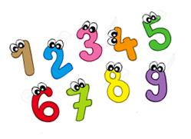
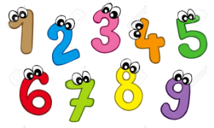
Counting and Numbers
Year 1 | Year 2
Recite numbers up to 100 forwards and backwards and from different starting points | Recite numbers beyond 100 forwards and backwards and from different starting points
Read and write numbers to at least 20 forming and orientating them correctly | Read and write numbers to at least 100 forming and orientating them correctly

Slide 13

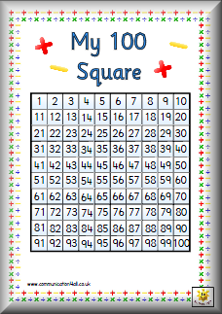
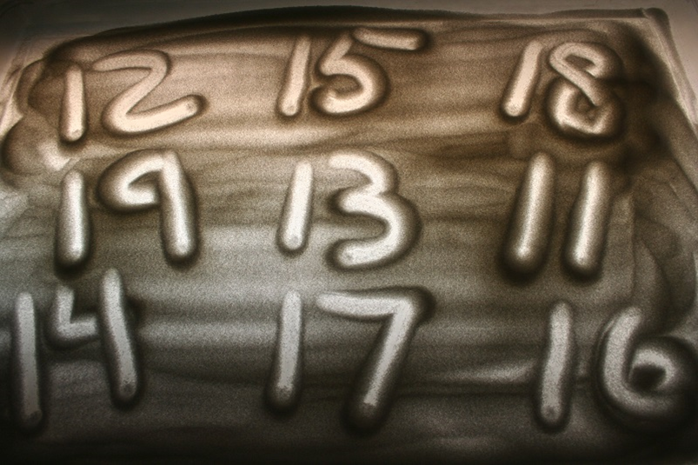
Counting and Numbers

Slide 14
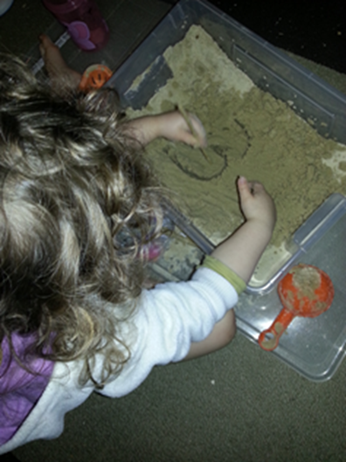
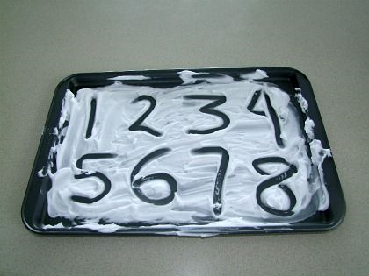
Counting and Numbers

Slide 15
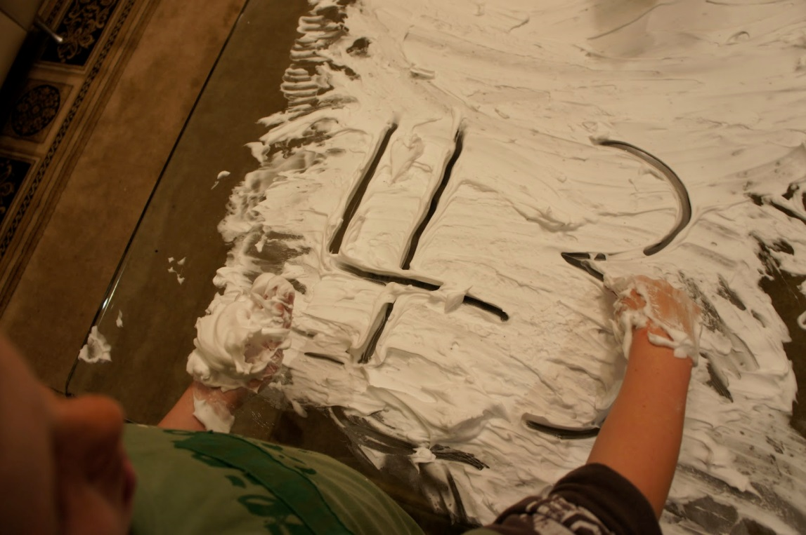
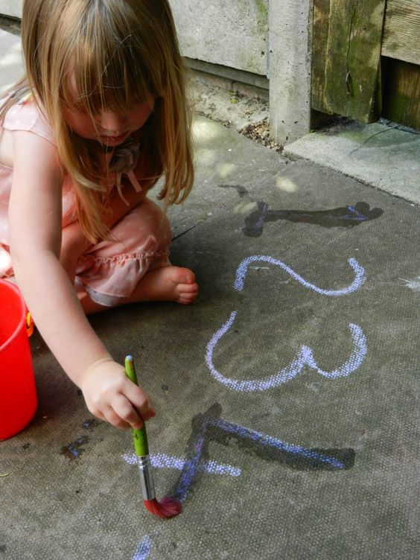

Slide 16


Slide 17
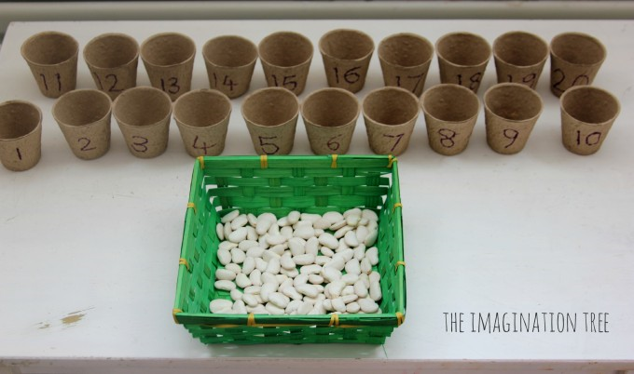
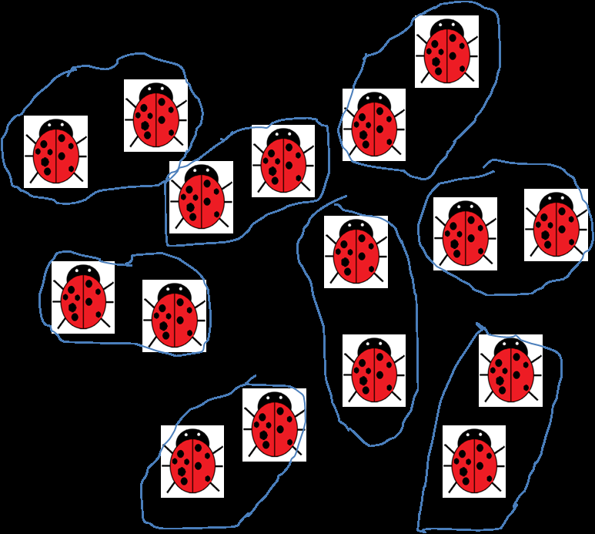
Counting and Numbers
Year 1 | Year 2
Count reliably up to 20 objects | Count sets of objects by grouping in 2s, 5s and 10s

Slide 18
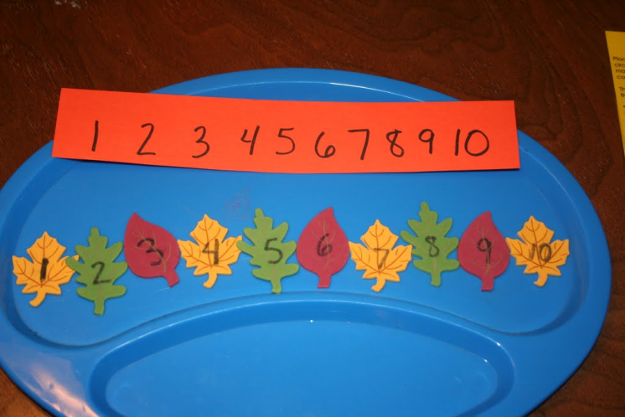
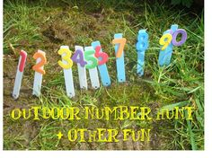
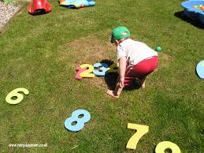
Counting and Numbers
Year 1 | Year 2
Compare and order numbers to at least 20 | Compare and order 2 digit numbers

Slide 19

14
29
33
39
43
Smallest
Largest

Slide 20
27
21
17
7
5
Largest
Smallest

Slide 21
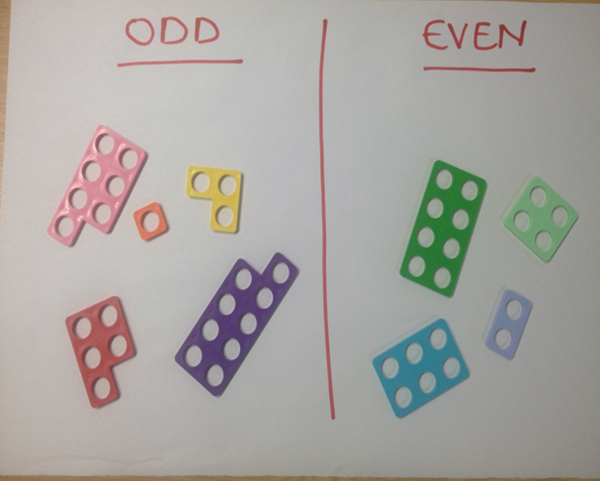
Counting and Numbers
Year 1 | Year 2
Recognise odd and even numbers up to 20 | Recognise odd and even numbers up to 100

Slide 22
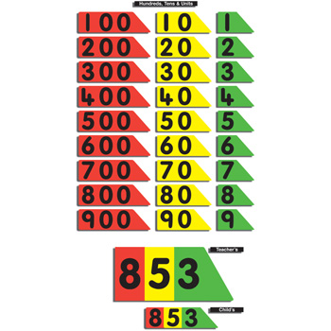
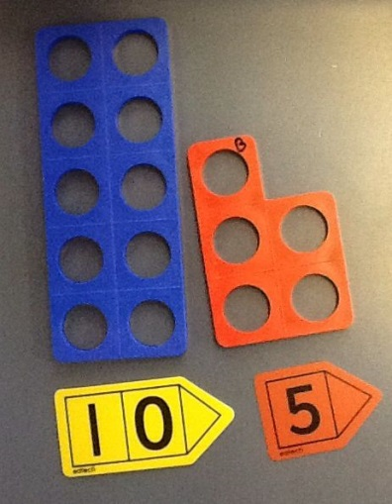
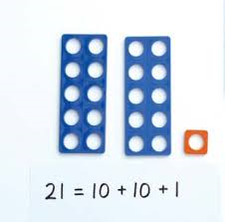
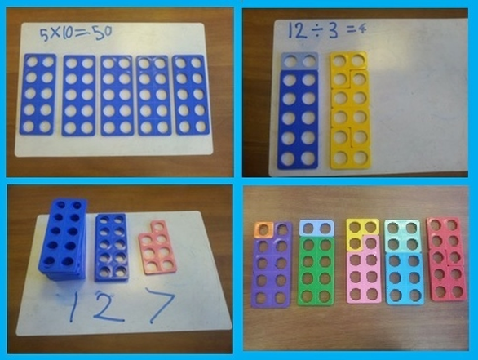
Counting and Numbers
Year 1 | Year 2
Demonstrate an understanding of place value e.g one 10 and four units equal 14, up to at least 20 | Demonstrate an understanding of place value to at least up to 100.

Slide 23
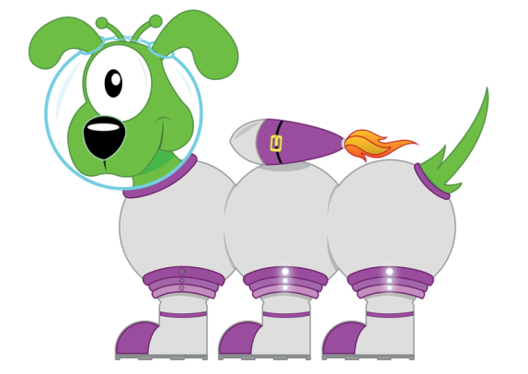
7
3
Let’s partition 73 into seventy and three.
3
7
0
Seventy
Three

Slide 24
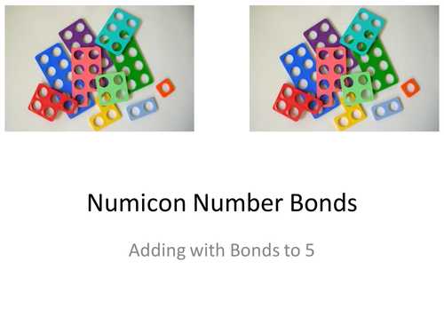
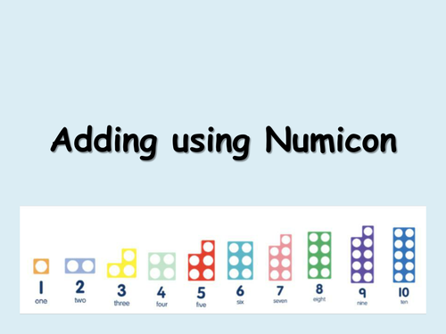
Counting and Numbers
Numicon

Slide 25
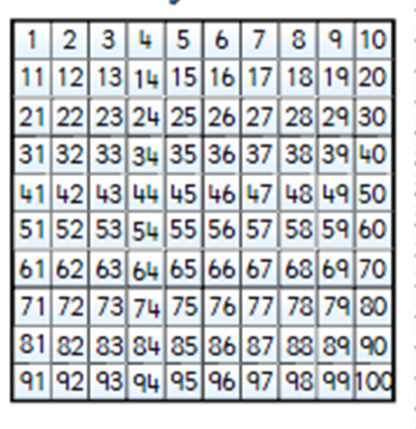

Counting and Numbers
Year 1 | Year 2
Use ‘counting on’ strategies to add two collections, starting with the larger number e.g. 8 + 5 | Use ‘counting on’ strategies to add two collections, starting with the larger number e.g. 38 + 7 Use ‘counting back’ strategies to take away

Slide 26
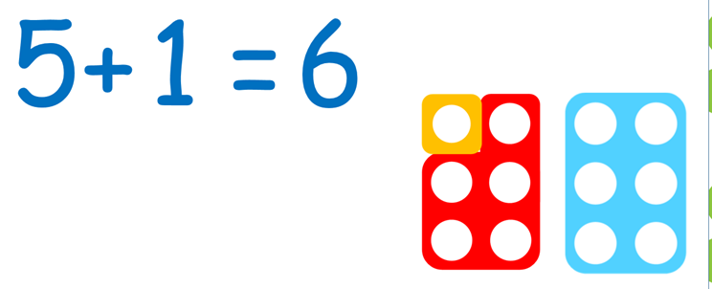
Counting and Numbers
Year 1 | Year 2
Know number facts / number bonds of numbers 5,6,7,8,9 and 10 - addition and subtraction (Son am bondiau rhif) | Use mental recall of number facts up to 10 to derive other facts 4+4=8 40 +40 = 80 6+ 4= 10 60 + 40 = 100 5+4 = 90 50 + 40 = 90 **same with subtraction

Slide 27
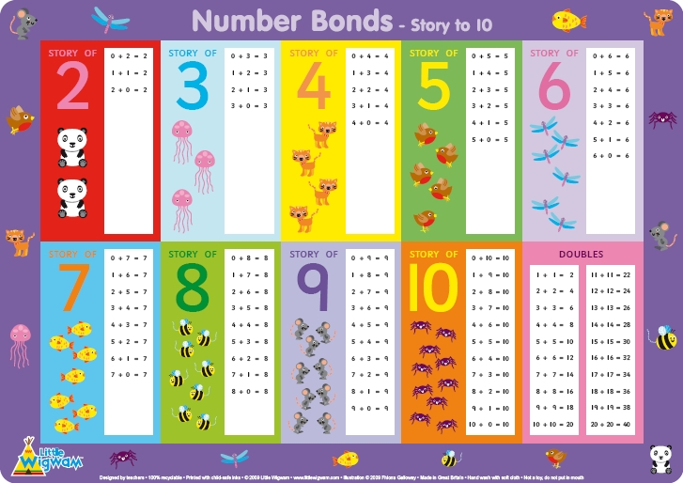

Slide 28
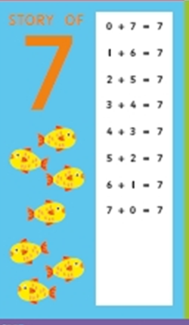
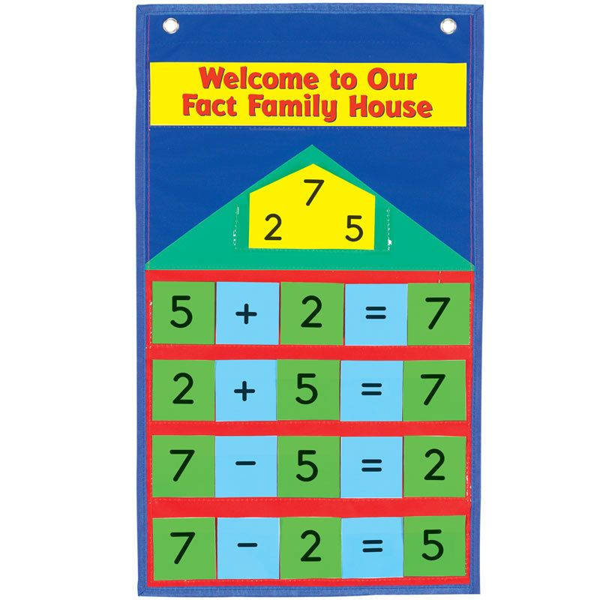

Slide 29

A fedrwch chi ddod o hyd i’r 2 ffaith adio a’r 2 ffaith tynnu?
8
+-
2
6

Slide 30
Let’s wire the numbers up!!
15
x÷
3
5

Slide 31




Counting and Numbers
Year 1 | Year 2
Number facts - missing numbers 7 +__ = 9 __ + 5 = 9 | missing number problems e.g 40 - ___=19

Slide 32
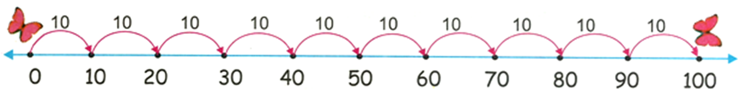
40 - ___ = 19
1

Slide 33

Counting and Numbers
Year 1 | Year 2
Use known number facts when adding 3 numbers e.g…….. | Understand that multiplication is repeated addition, e.g, 2+2+2 is the same as ‘three two’s’ Numicon multiplication!!!
3 + 5 + 7 =

Slide 34
Counting and Numbers
Year 1 | Year 2
Count in 2’s, 10’s and 5’s to 100. Counting in 10’s also means 3, 13, 23,33,43 etc | Count in 2’s, 10’s and 5’s from any given number
Count in 10’s to 100 0,10,20,30,40,50,60,70,80,90,100! | Recall and use the 2,5, and 10 times table

Slide 35
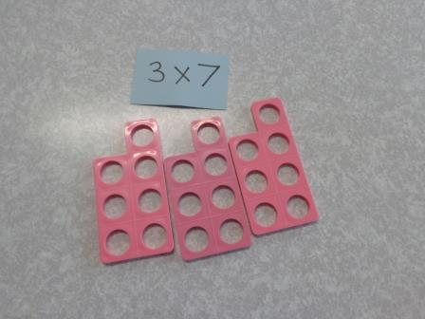

Slide 36
4
x
2
=
set o
=
4 set o 2 yn gweud

Slide 37
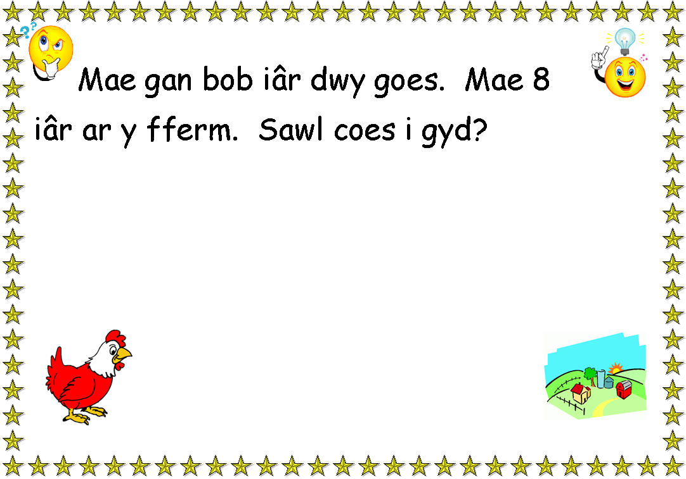

Slide 38
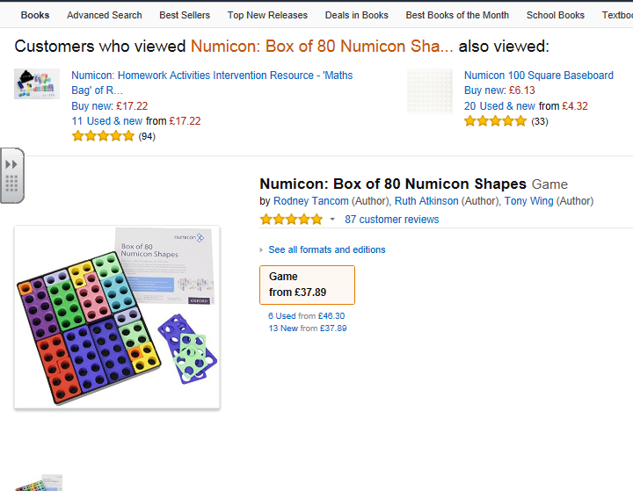

Slide 39
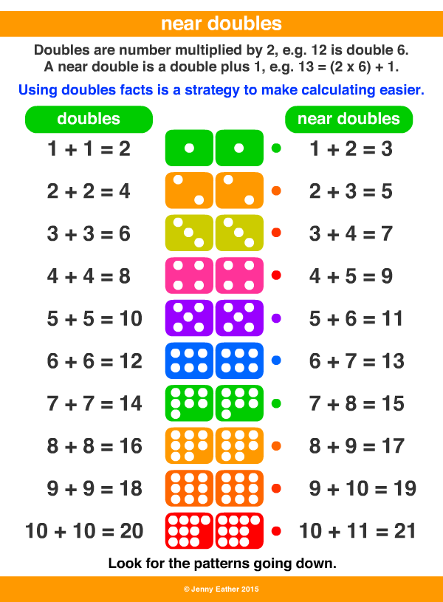
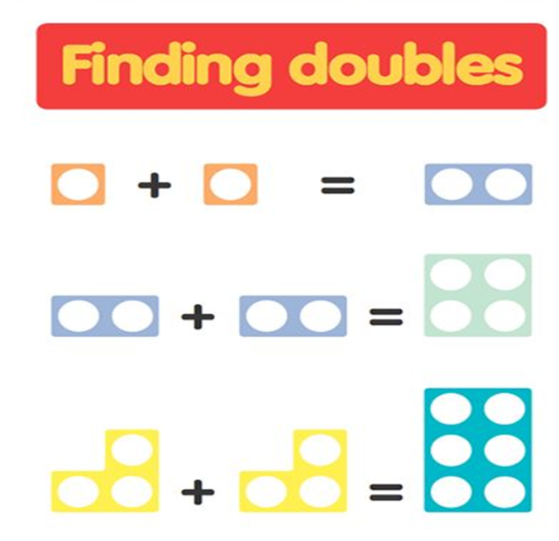
Counting and Numbers
 | Year 2
 | Recall doubles and near doubles up to 20 Recall halves up to 20

Slide 40
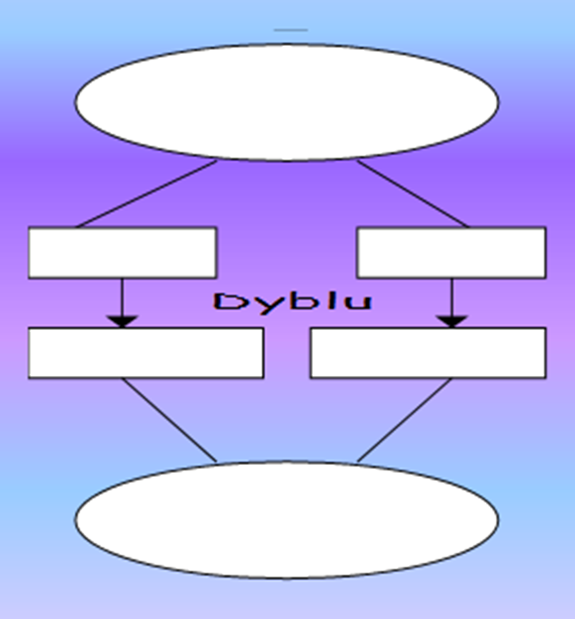
Counting and Numbers
 | Year 2
 | Partition 2 digit numbers and know the value of each number, partition to find out doubles and halve of numbers
14
10
4
20
8
28

Slide 41
Counting and Numbers
 | Year 2
 | Partition 2 digit numbers and know the value of each number, partition to find out doubles and half of numbers
36
30
6
60
12
72

Slide 42







Counting and Numbers
 | Year 2
 | Begin to link multiplication with simple division e.g. grouping and sharing in 2s 5s and 10s
12 2 =

Slide 43
Counting and Numbers
Year 1 | Year 2
Mentally recall one more / one less of a numbers to 20 | Mentally add 10 and 20 to a given number up to 100 23 +20, 20 + 13 Also subtract ….

Slide 44
20 + 23 =
43

Slide 45
Counting and Numbers
Year 1 | Year 2
 | Add and subtract 9 / 11 from a given number using knowledge of adding / subtracting 10 34 + 10 = 44 34 + 9 = 43

Slide 46

Counting and Numbers
Year 1 | Year 2
Solve simple problems in a practical situation that involve simple addition and subtraction up to at least 10 | Solve one and two step problems that involve addition and subtraction, multiplication and division

Slide 47



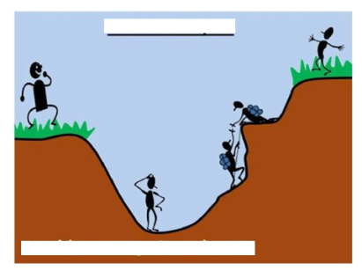
Datrys Problemau!
Beiciau 12c yr un
Mae Tomas yn prynu tri beic
Mae’n talu gyda £1
.
Faint o newid mae e’n cael?

Slide 48
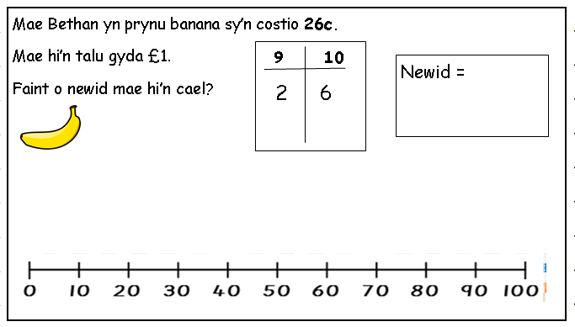
7
4

Slide 49
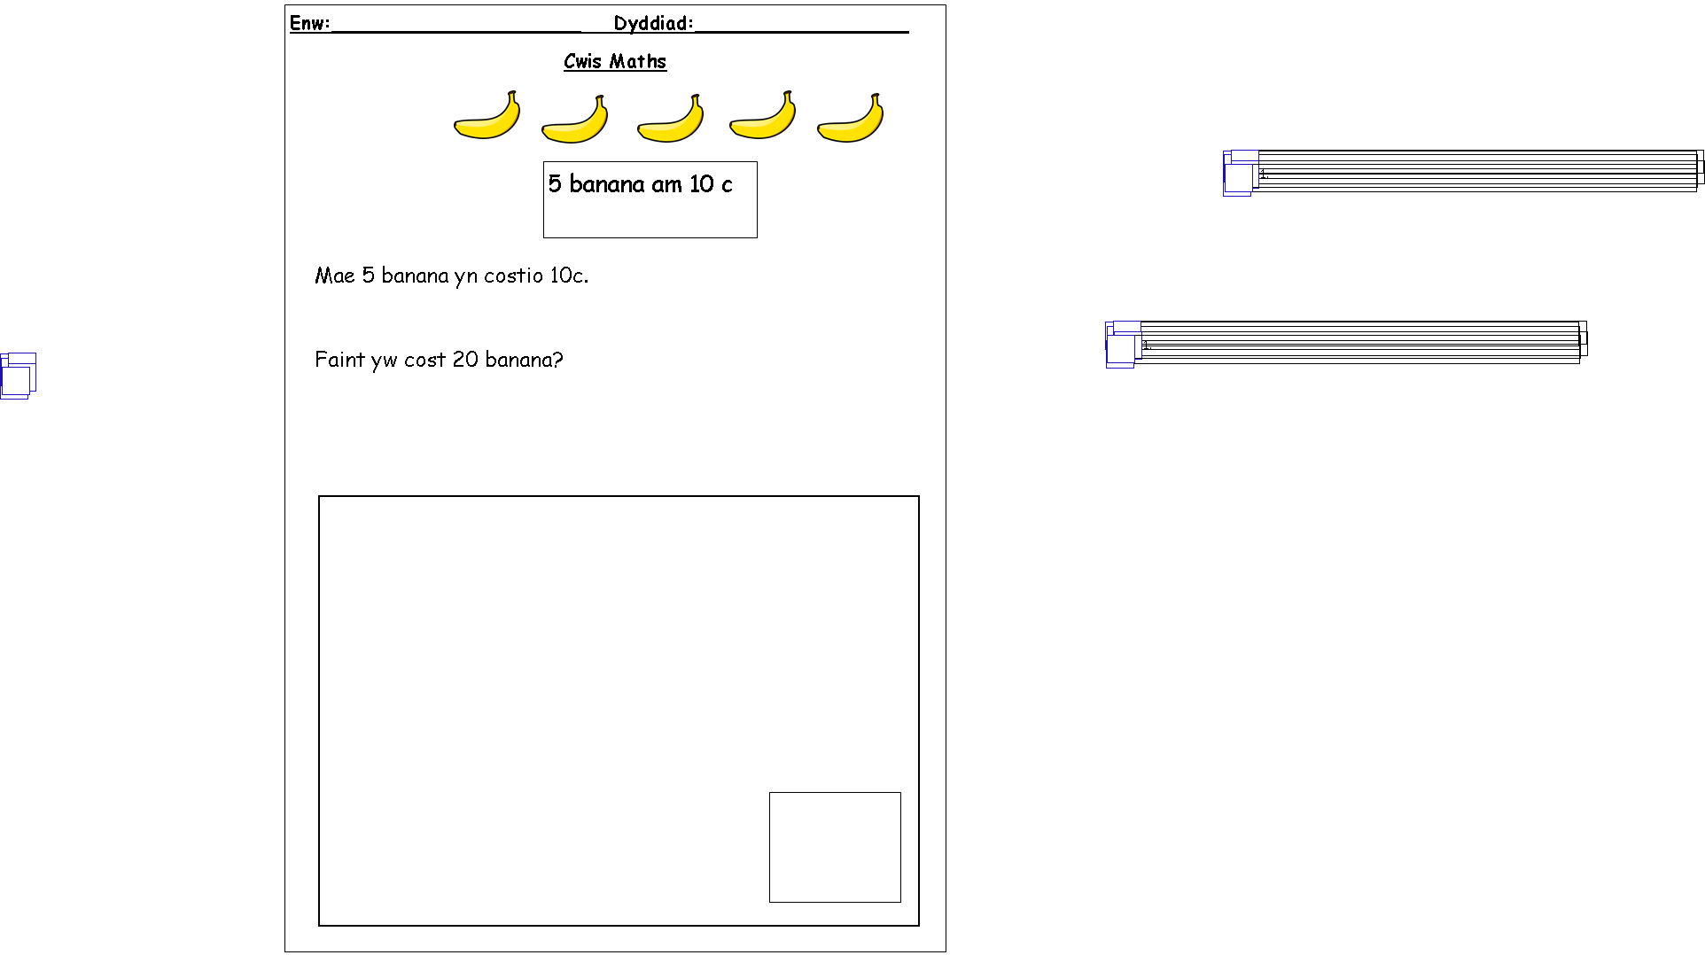






Slide 50
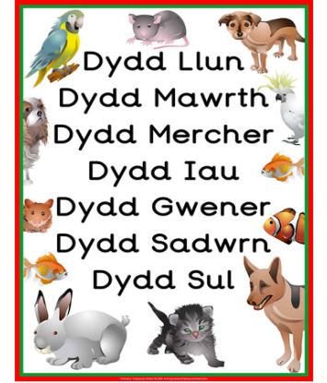
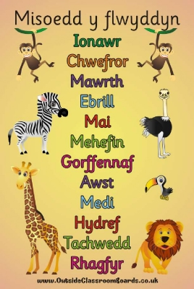
Counting and Numbers
Reception | Year 1
Sing / chant days of the week and months of the year | Understand the order of the days of the week, the months of the year and the seasons

Slide 51


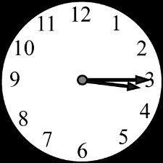

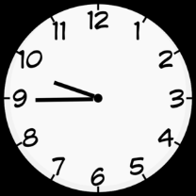



Time
Year 1 | Year 2
Use standard units of time to read ‘o’clock’ using both analogue and 12 hour digital clock | Read half past, quarter to and quarter past using both a digital and analogue clock

Slide 52
Time
Year 1 | Year 2
 | Read hours and minutes on a 12 hour digital clock

Slide 53
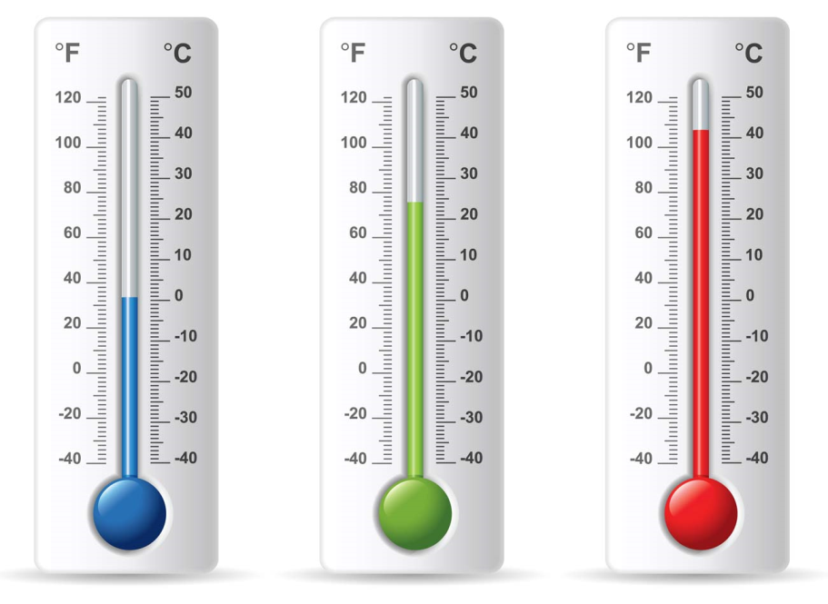
Time
Year 1 | Year 2
 | Compare daily temperature on a thermometer

Slide 54
Time
Year 1 | Year 2
 | Make sensible estimates of measurement in length, height weight and capacity

Slide 55
Time
Year 1 | Year 2
 | Use standard units to measure -length, height and distance, meters, half meters and centimetres -weight/mass: kilograms or 10 gram weights -capacity – litres

Slide 56
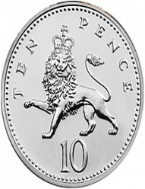
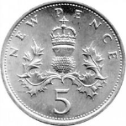

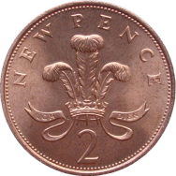
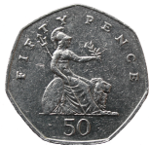
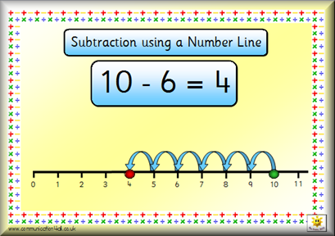
Money
Year 1 | Year 2
Use different combinations of money to pay for items up to 20p | Use different combinations of money to pay for items up to £1
Find totals and give change from 10p | Find totals and give change from £1 and multiples of 10 e.g. 30p

Slide 57
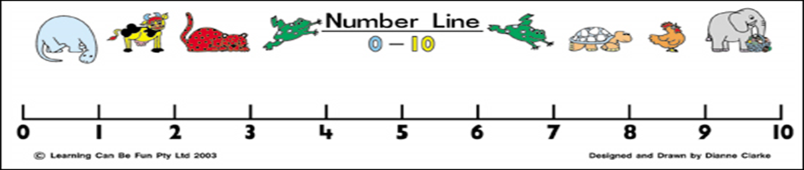




Slide 58
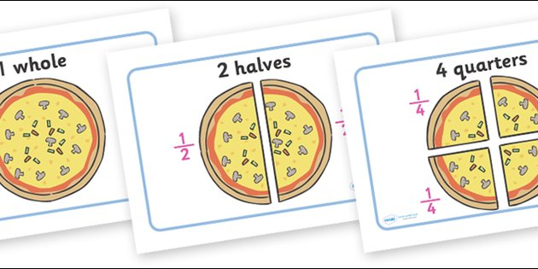
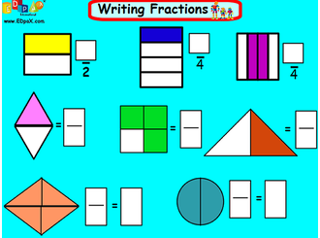
 | Year 2
 | Use halves and quarters in practical situation

Slide 59
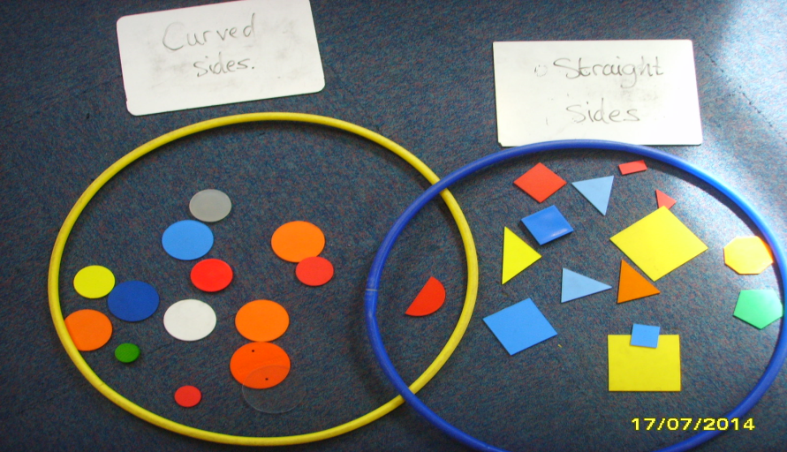

Shape
Year 1 | Year 2
Recognise and name common 2D and 3D shapes and be able to compare and sort these shapes | Recognise and name irregular 2d and 3d shapes, understand and use the properties of shape

Slide 60

Ordinal Language
Year 1 | Year 2
Use ordinal numbers to 20 | Use and record ordinal numbers in practical situations
1af
2ail
3ydd
4ydd
5ed

Slide 61


Place value – doubles

Slide 62


Slide 63



Slide 64

Bondiau 10
0+10

Slide 65


Slide 66


Bondiau 10!

