Slide 1


Croeso
Welcome
Bore Mathemateg

Slide 2


Questionnaire

Slide 3
Thank you for giving up your time!
Research shows that it’s your participation and engagement that ensures your child’s success

Slide 4
‘Parental involvement in children’s education from an early age has a significant effect on educational achievement, and continues to do so into adolescence and adulthood.’
“ In the early years, parental involvement has a significant impact on children’s cognitive development and literacy and number skills”

Slide 5
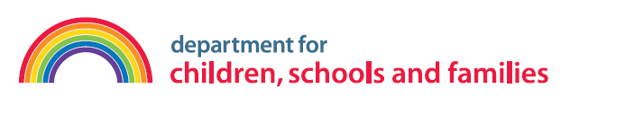
‘What parents do is more important than who they are for children’s early development – i.e. home learning activities undertaken by parents is more important for children’s intellectual and social development than parental occupation, education or income.’
The Impact of Parental Involvement on Children’s Education
Department for Children, School and Families

Slide 6

Question 3:
At age seven, how influential is family engagement in learning compared with the quality of the school for a child’s educational attainment?
a. Family engagement has less influence than school quality
b. Family engagement has equal influence to school quality
c. Family engagement has twice as much influence as school quality
d. Family engagement has six times as much influence as school quality

Slide 7
Question 3 :
At age seven, how influential is family engagement in learning compared with the quality of the school for a child’s educational attainment?
d. Family engagement has six times as much influence as school quality
Source: Desforges and Abouchaar (2003) The impact of parental involvement, parental support and family education on pupil achievement and adjustment. Cited in FaCE the challenge together: Family and community engagement toolkit for schools in Wales

Slide 8


What is expected of Nursery / Reception Children?

Slide 9
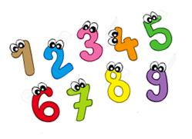
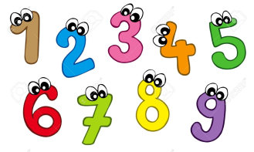
Counting and Numbers
Nursery | Reception
Recite numbers from 0-10, forwards and backwards starting from different numbers | Recite numbers up to 20 forwards and backwards from different starting points
Recognise numbers from 0-5 | Read and write numbers to at least 10

Slide 10
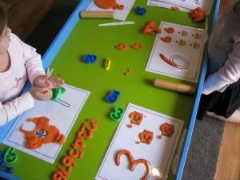
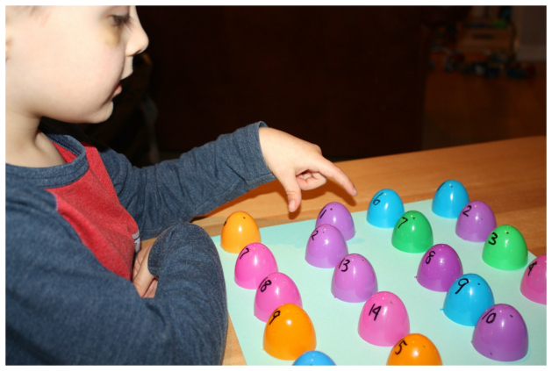
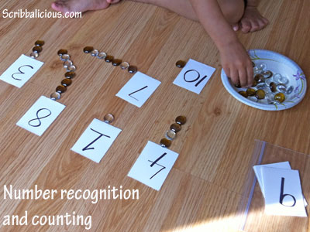
Counting and Numbers

Slide 11
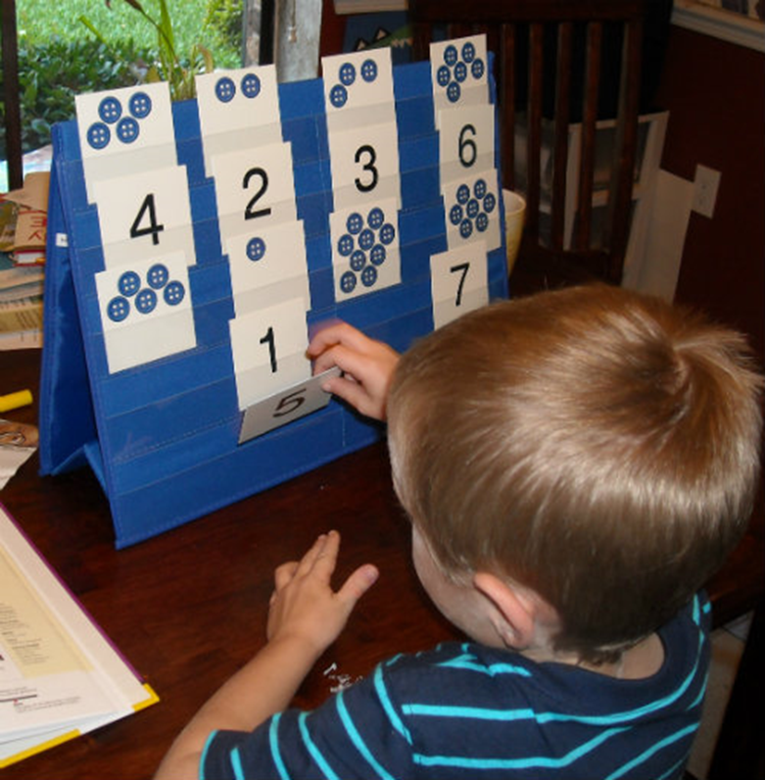
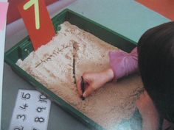
Counting and Numbers

Slide 12
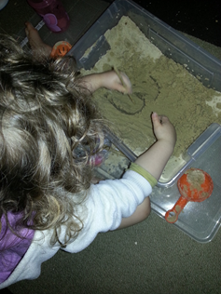
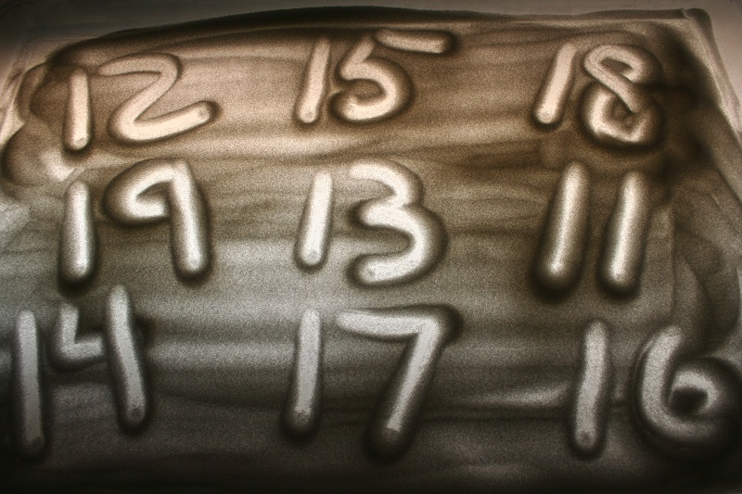
Counting and Numbers

Slide 13
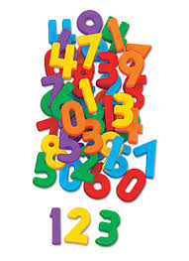
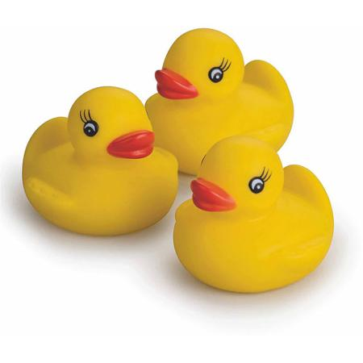
Counting and Numbers

Slide 14
Counting and Numbers
Nursery | Reception
Count reliably up to 5 objects | Count reliably up to 10 objects
Secure number conservation from 0-5 | Secure number conservation 0-10

Slide 15
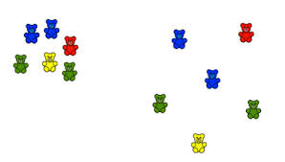
Counting and Numbers
Number conservation……….

Slide 16


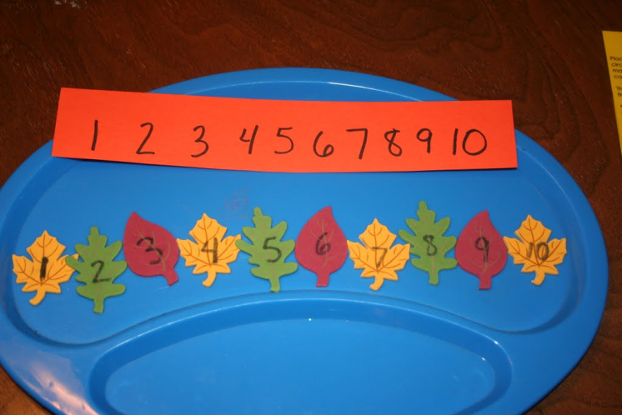
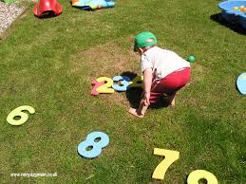
Counting and Numbers
Nursery | Reception
Compare and order numbers up to 5 | Compare and order numbers up to 10

Slide 17
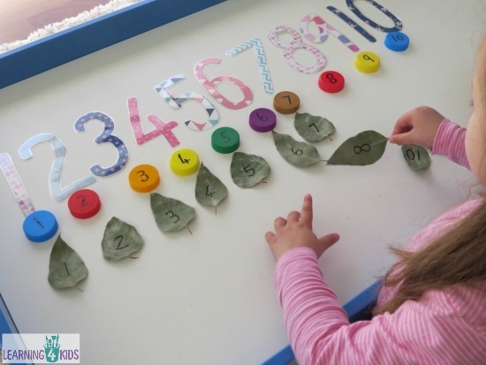

Slide 18
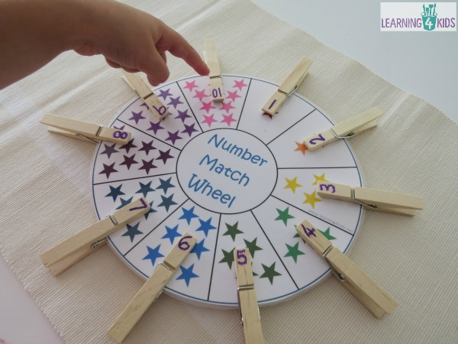
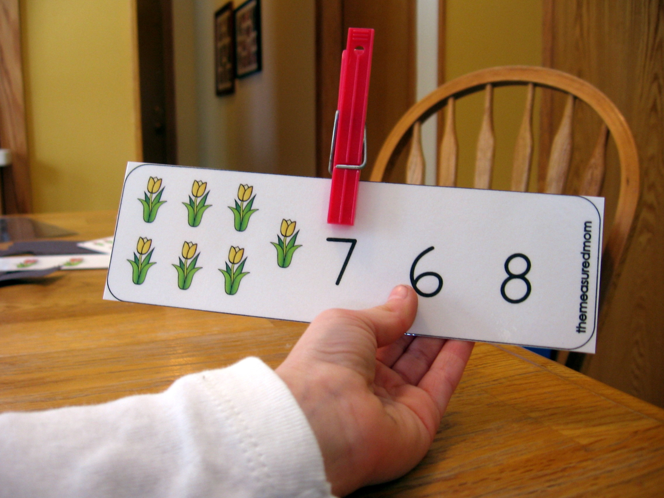

Slide 19
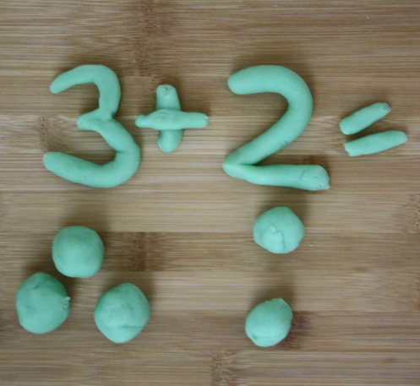
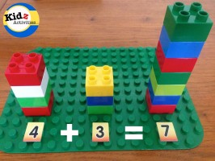
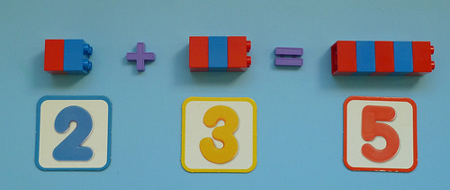
Counting and Numbers
Nursery | Reception
 | Combine two groups of objects to find ‘how many altogether’ (addition)

Slide 20
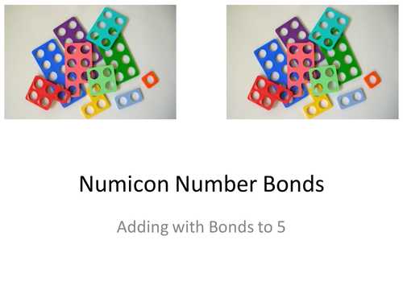
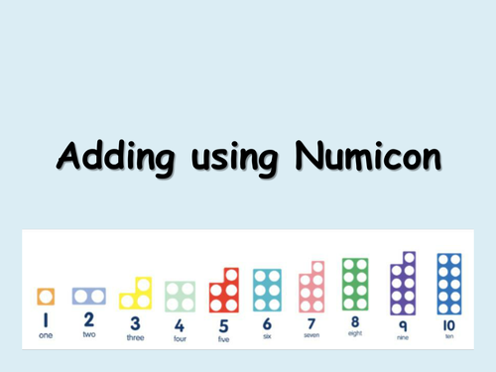
Counting and Numbers
Numicon

Slide 21
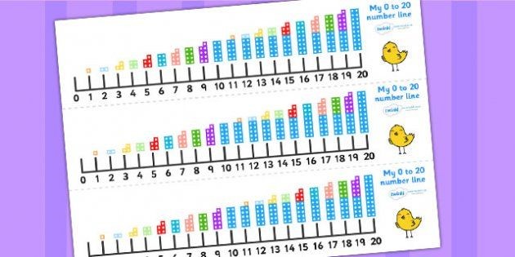

Slide 22
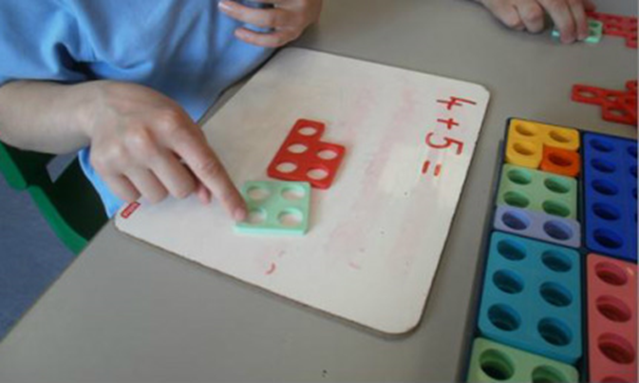
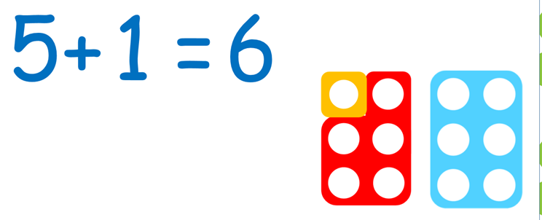
Counting and Numbers
Nursery | Reception
 | Combine two groups of objects to find ‘how many altogether’ (addition)

Slide 23
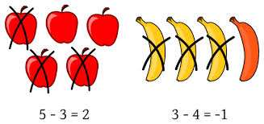
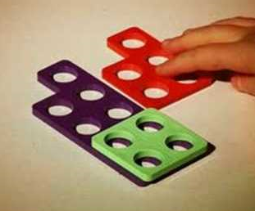
Counting and Numbers
Nursery | Reception
 | Take away objects to find out how many are left (subtraction)

Slide 24

Counting and Numbers
Nursery | Reception
 | Solve simple problems in a practical situation that involve simple addition and subtraction up to 5

Slide 25
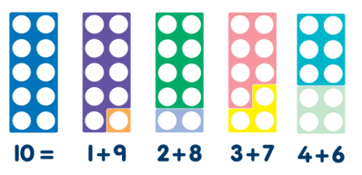



Counting and Numbers
Nursery | Reception
 | Use number facts to 5
Number Facts
Number Bonds

Slide 26
Counting and Numbers
Nursery | Reception
 | Count in 2’s to 10 0,2,4,6,8,10
 | Count in 10’s to 100 0,10,20,30,40,50,60,70,80,90,100!

Slide 27
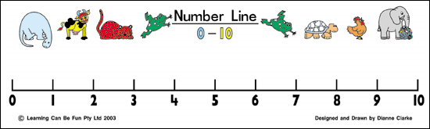
Counting and Numbers
Nursery | Reception
Understand the concept of ‘one more’ and ‘one less’ in their play. ‘un arall/ un yn fwy, un yn llai’ | Mentally recall one more / one less of a number within 10

Slide 28
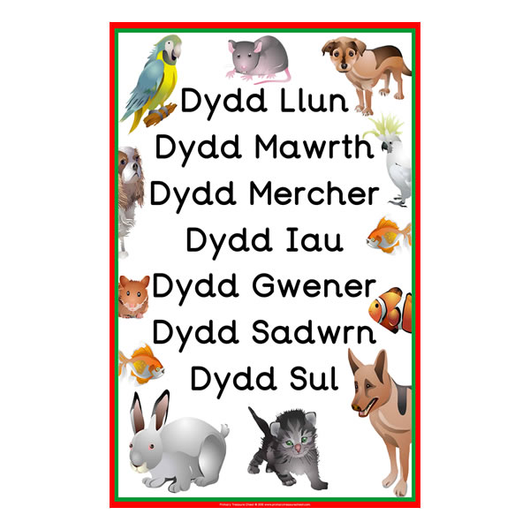
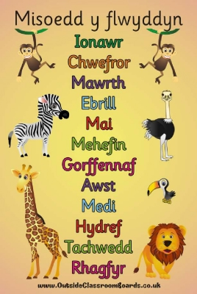
Counting and Numbers
Nursery | Reception
Sing / chant days of the week | Sing / chant days of the week and months of the year

Slide 29

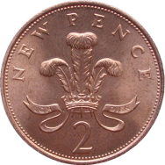
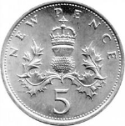
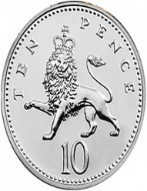
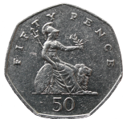
Money
Nursery | Reception
Use coins in role play | Use 1p, 2p 5p and 10p coins to pay for items

Slide 30
Shape
Nursery | Reception
Recognise and use the names for 2D shapes | Recognise and name common 2D and 3D shapes

Slide 31
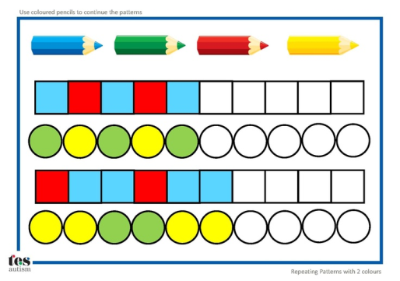
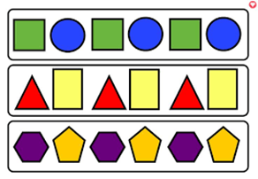
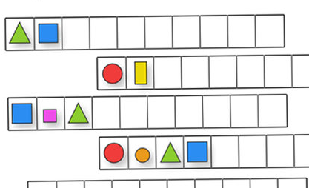
Shape
Nursery | Reception
Copy a range of simple patterns and sequences visually and aurally e.g. clapped patterns threading activities | Recognise and repeat three object / clapped patterns and sequences

Slide 32
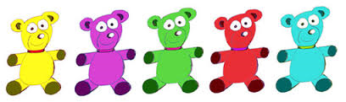
Ordinal Language
Nursery | Reception
Use terms 1st, 2nd, 3rdin their play (in Welsh) 1af, 2ail, 3ydd | Use ordinal numbers up to 10
1af
2ail
3ydd
4ydd
5ed

Slide 33
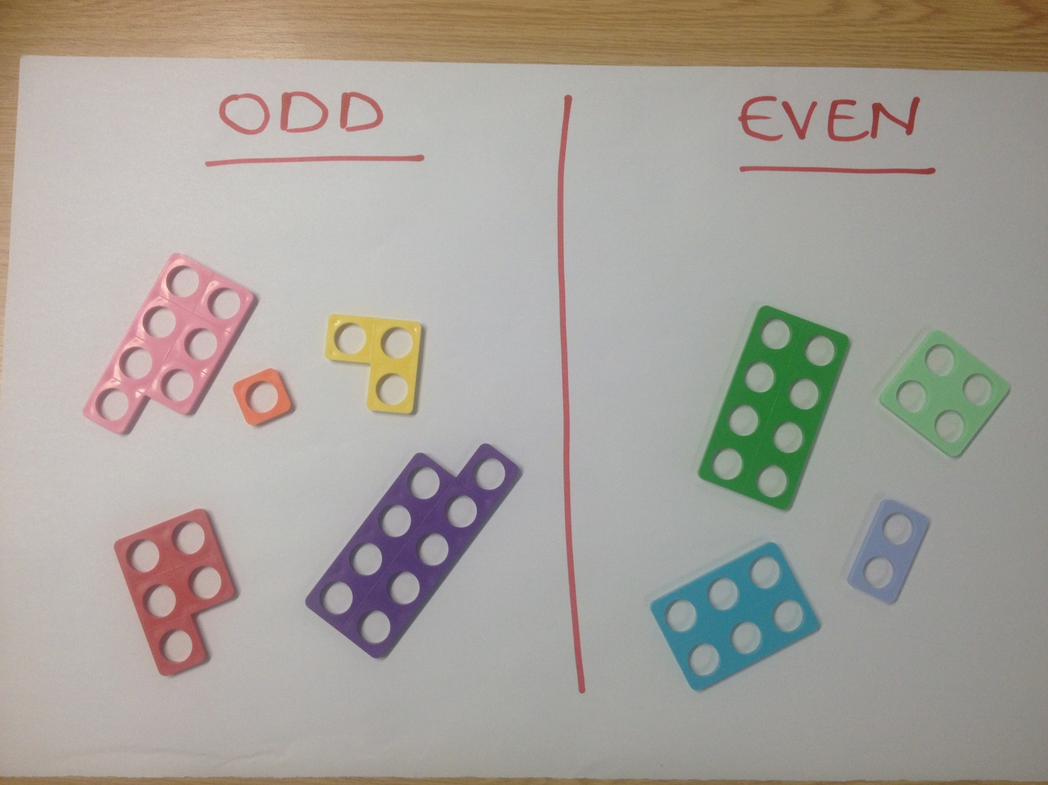

Slide 34
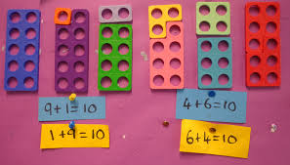

Place value – doubles

Slide 35
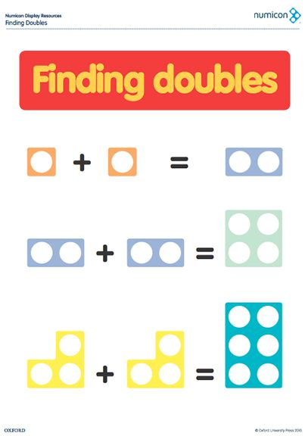

Slide 36
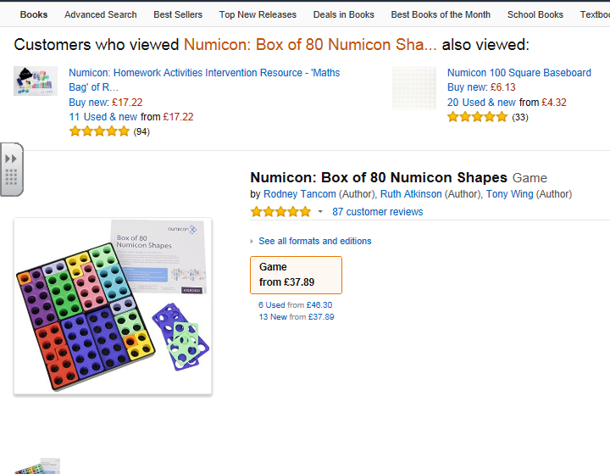

Slide 37

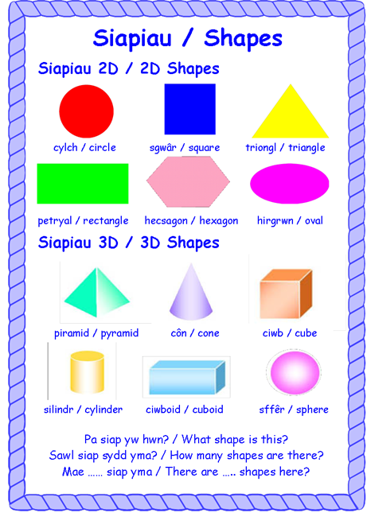
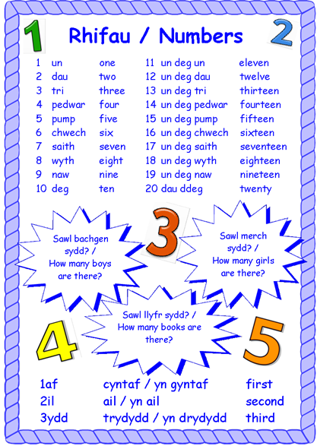

Slide 38






Yr Odrifau
1 3 5 7 9

Slide 39






Yr Eilrifau
2 4 6 8 10

