Slide 1

Bore da!
Cyflwyniad rhifedd CA2
KS2 Numeracy presentation
Rhodri Jones, numeracy coordinator
12/3/19

Slide 2
Today’s aims
Offer opportunity to observe a CLIC session (mental arithmetic)
Explain Big Maths (CLICs, Learn-Its, SAFEs)
Give parents an overview of how we approach Maths at YGC, and perhaps provide some strategies that can be emulated at home
Ensure parents have access the curriculum and numeracy Framework
Provide resources and practice papers
Discuss methods which may aid pupils at home
Explain how we assess pupils and act on these assessments

Slide 3
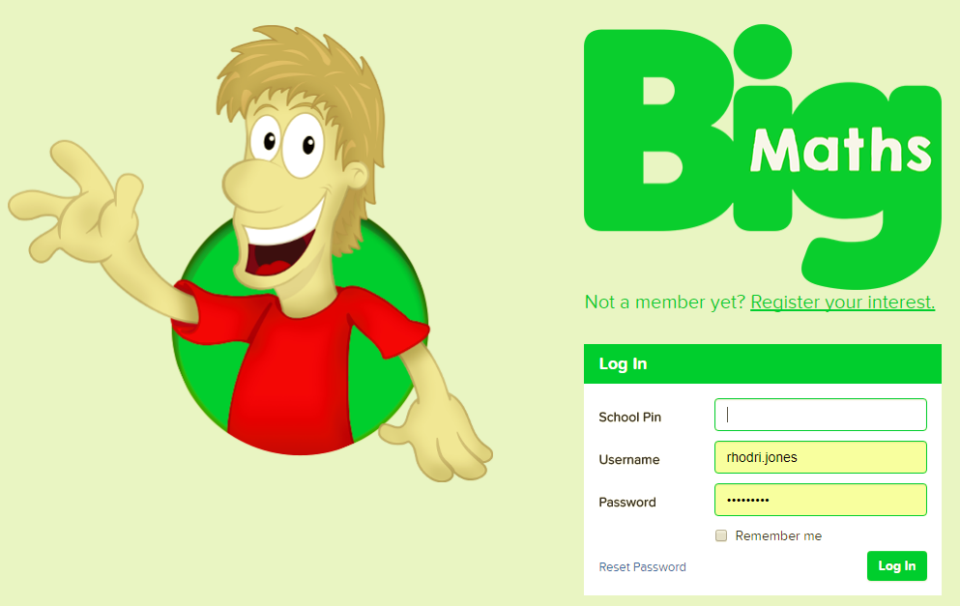
Why Big Maths?
Clear progression from year to year
Consistent methods taught and language used throughout the school
Build on prior learning and ensure children are secure in their knowledge
Objectives are clearly matched to National Curriculum objectives
Clear links with AFL so evidence can be gathered easily to inform planning/assessment
Improve mental maths skills and general numeracy across the school

Slide 4
http://www.andrelleducation.com/big-maths/

Slide 5
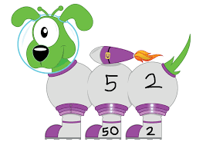
What is CLIC?
The four elements of CLIC are:
Counting
Learn Its
It’s Nothing New
Calculation

Slide 6
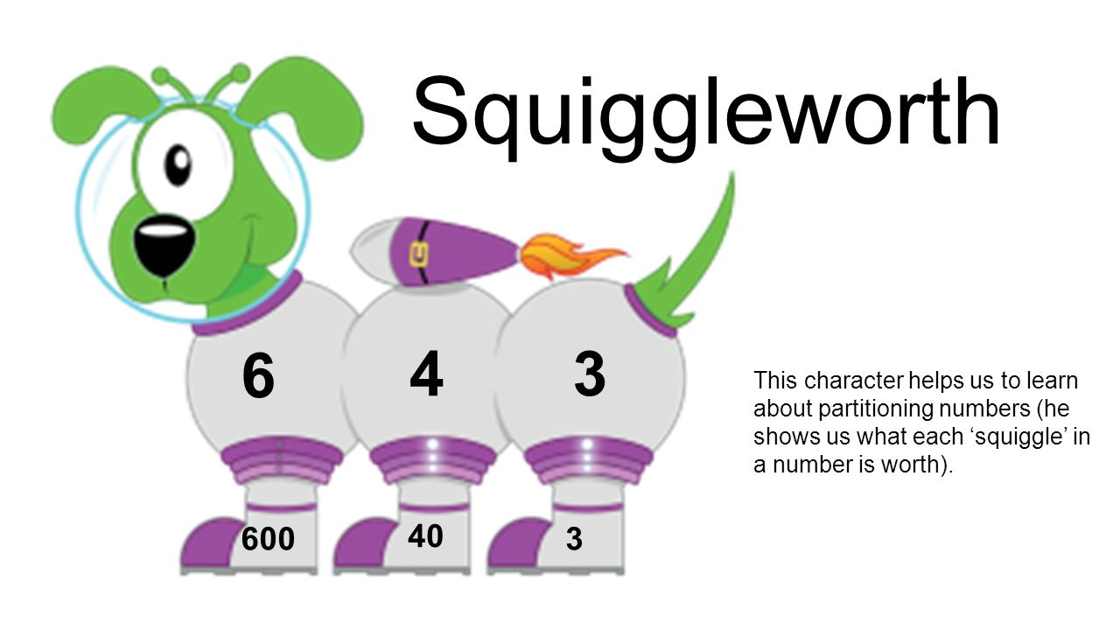
Consistency

Slide 7

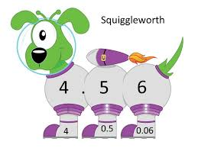
Consistency

Slide 8
CLIC is a sequential programme of daily basic skills for Numeracy. It provides a
constant, daily drive to improve children’s Numeracy.

Slide 9
CLIC
First: Learn to count (Counting)
Second: Learn to remember totals as facts (Learn Its)
Third: Learn to apply those facts in new situations through ‘swapping’ the ‘thing’ being counted (It’s Nothing New)
Fourth: Learn to structure all the previous three into a formal calculation (Calculations)
Counting
Learn Its
It’s Nothing New
Calculation

Slide 10

How is the daily maths lesson organised?
Monday to Thursday:
Counting – 5 minutes
Learn Its – 5 minutes
It’s Nothing New – 5 minutes
Calculations – 5 minutes

Slide 11
So what happens on a Friday?

Slide 12
So what happens on a Friday?
1. Big Maths Beat That – timed challenge where children answer ‘Learn Its’ questions. The aim is to beat their previous score.
2. CLIC – 10 questions relating to concepts taught at children’s individual level. Once they have scored 10 out of 10 three weeks in a row, they move on to the next level.
3. SAFE – Shape, Amount, Fractions, Explaining Data
4. Problem solving & reasoning activities – opportunities to apply strategies

Slide 13
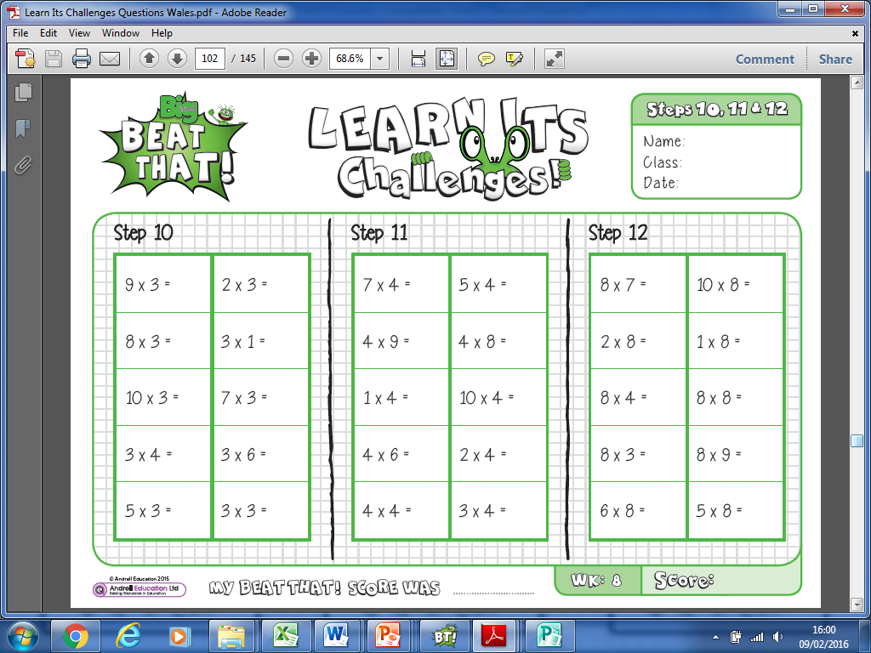
Learn-Its

Slide 14
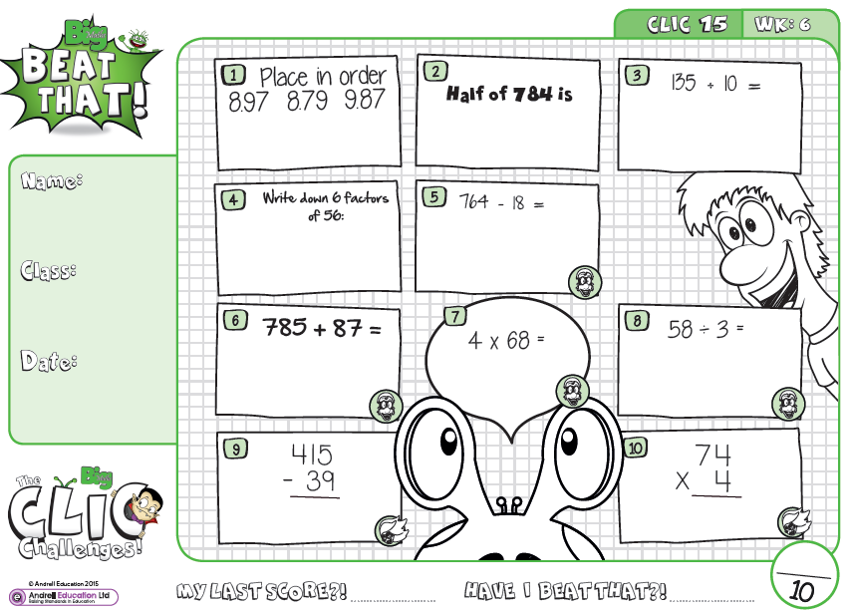
CLIC
CLIC 15 (of 20)

Slide 15
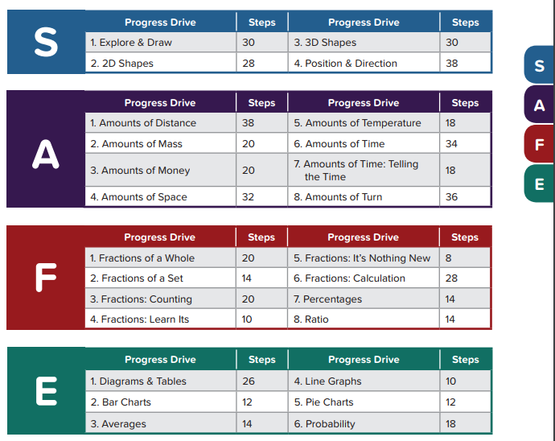
SAFE

Slide 16
How can I support my child?
Learn-Its
Times Tables!
Help your child practise their ‘Learn Its’ at home. Introduce 1, 2 or even 3 new facts each week.
Practice
Create, download, alter, flip any numeracy questions you see.
16 7 = 9
5 + ? = 12
How many people are in Asda right now?
How tall is that door?
What is the opposite of multiplication?
Encourage, support & praise
Support with homework using the examples given by the teacher. Ask your child to talk through the examples and relate this to work they have been doing in class – encourage them to teach you!

Slide 17
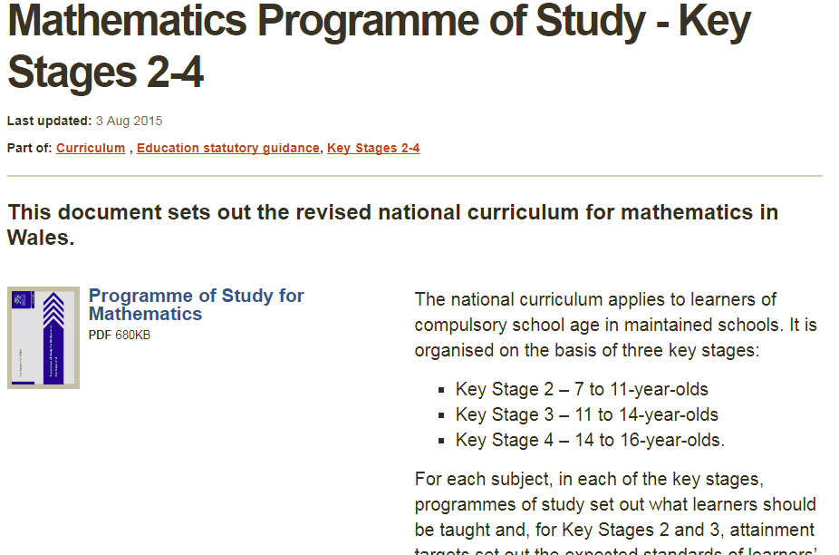
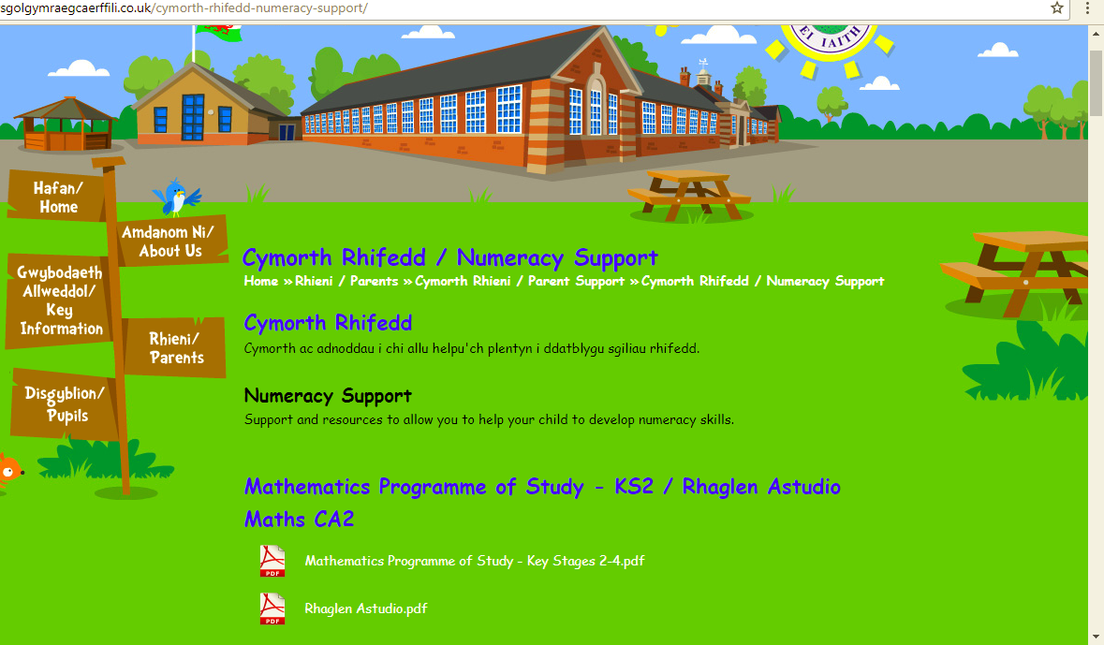
What do we teach?
Mathematics Programme of Study – Key Stage 2 - the revised national curriculum for mathematics in Wales.

Slide 18
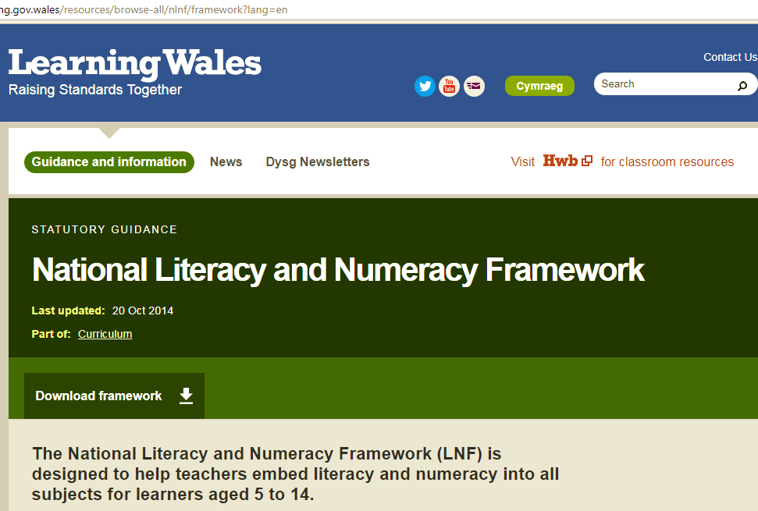
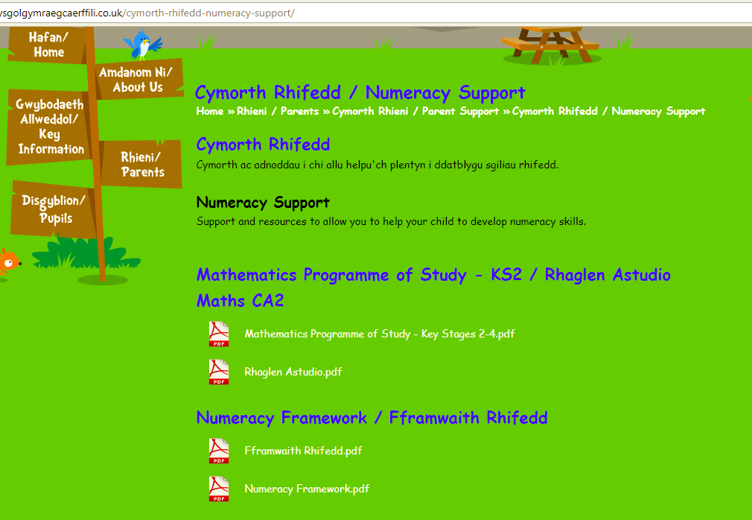
What do we teach?
National Literacy and Numeracy Framework

Slide 19
Any questions?

