Slide 1

Croeso a bore da!
Cyflwyniad rhifedd CA2
KS2 Numeracy presentation
Rhodri Jones, Numeracy coordinator
12/2/2020

Slide 2
Today’s aims
Observe a mental arithmetic (CLIC) session
Explain Big Maths (CLICs, Learn-Its, SAFEs)
Give parents an overview of how we approach Maths at YGC, and perhaps provide some strategies that can be emulated at home
Ensure parents have access the curriculum and numeracy Framework
Provide resources and practice papers
Discuss methods which may aid pupils at home
Explain how we assess pupils and act on these assessments

Slide 3
“Numeracy standards in this school are excellent.”
Lynn Griffiths, 11/02/20
Last year 98% of Y6 pupils reached or exceeded National expected level in Numeracy.
Last 5 years: average of 40% – 50% Y6 pupils achieved the higher level in Numeracy.

Slide 4
Reasons
Strong leadership (according to Mr Griffiths)
Encouraging environment
Enjoyable, practical lessons
Supportive parents such as yourselves
Consistency in practice
Teachers who are confident in delivery of the current & new curriculum*
Effective Numeracy programme – Big Maths

Slide 5
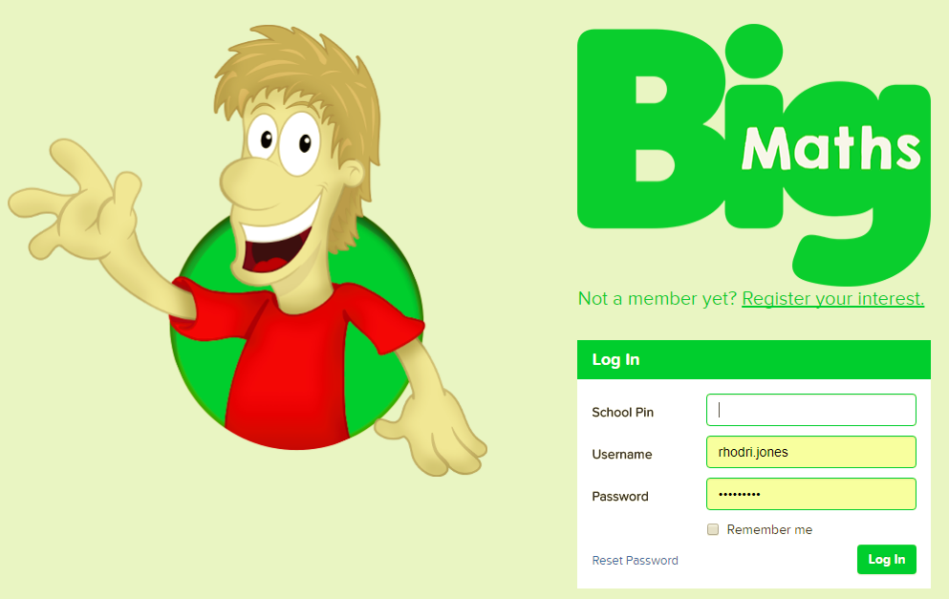
Why Big Maths?
Clear progression from year to year
Consistent methods taught and language used throughout the school
Build on prior learning and ensure children are secure in their knowledge
Objectives are clearly matched to National Curriculum objectives
Assessed weekly - evidence can be gathered easily to inform planning/assessment
Improve mental maths skills and general Numeracy across the school
Most importantly, pupils seem engaged and to enjoy weekly CLICs, Learn-Its and SAFEs!
http://www.andrelleducation.com/big-maths/

Slide 6
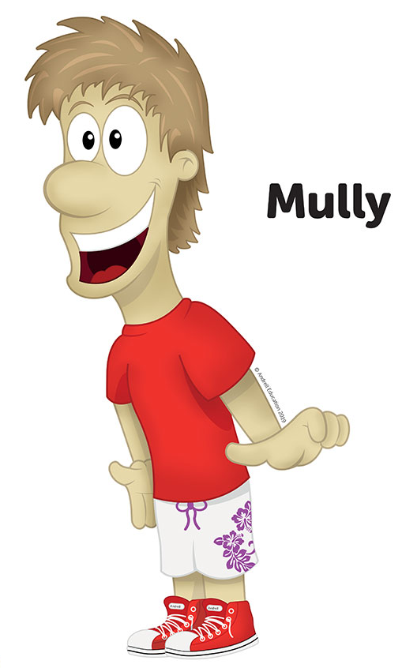
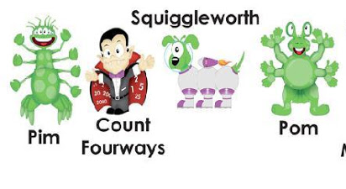
Big Maths characters

Slide 7
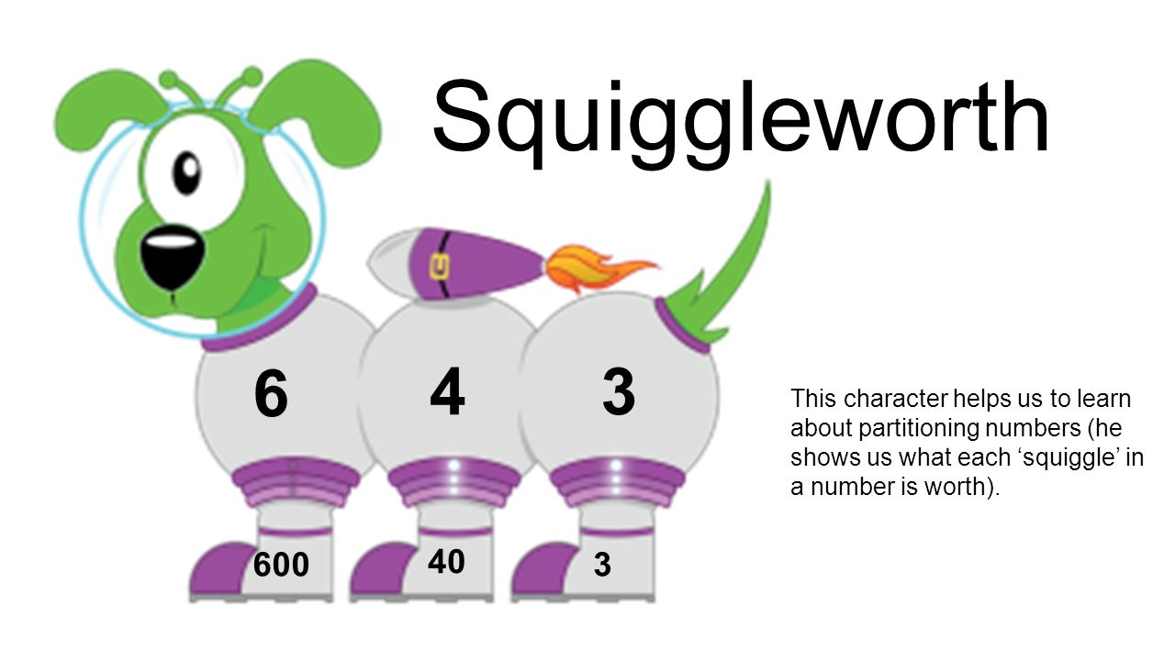
Consistency

Slide 8

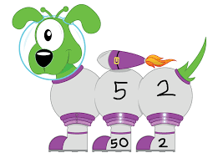
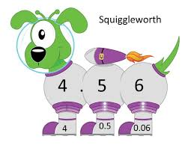
Consistency

Slide 9
What is CLIC?
The four elements of CLIC are:
Counting
Learn Its (times tables, number bonds)
It’s Nothing New
Calculation

Slide 10
CLIC
First: Learn to count (Counting)
Second: Learn to remember totals as facts (Learn Its)
Third: Learn to apply those facts in new situations through ‘swapping’ the ‘thing’ being counted (It’s Nothing New)
Fourth: Learn to structure all the previous three into a formal calculation (Calculations)
Counting
Learn Its
It’s Nothing New
Calculation

Slide 11
CLIC is a sequential programme of daily basic skills for Numeracy. It provides a
constant, daily drive to improve children’s Numeracy.

Slide 12
Weekly assessments?!
Pupils don’t see them as tests.

Slide 13
Weekly assessments
1. Learn Its – timed challenge where children answer questions. The aim is to beat their previous score.
2. CLIC – 10 questions relating to concepts taught at children’s individual level. Once they have scored 10 out of 10 three weeks in a row, they move on to the next level e.g. CLIC 12
3. SAFE – Shape, Amount, Fractions, Explaining Data
4. Problem solving & reasoning activities – opportunities to apply strategies

Slide 14
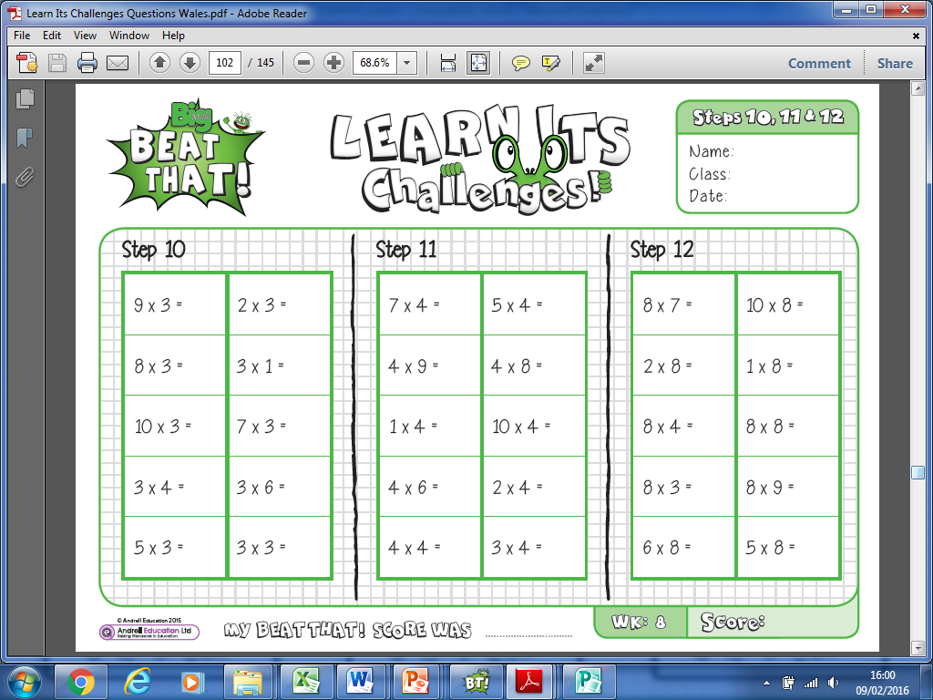
Learn-Its

Slide 15
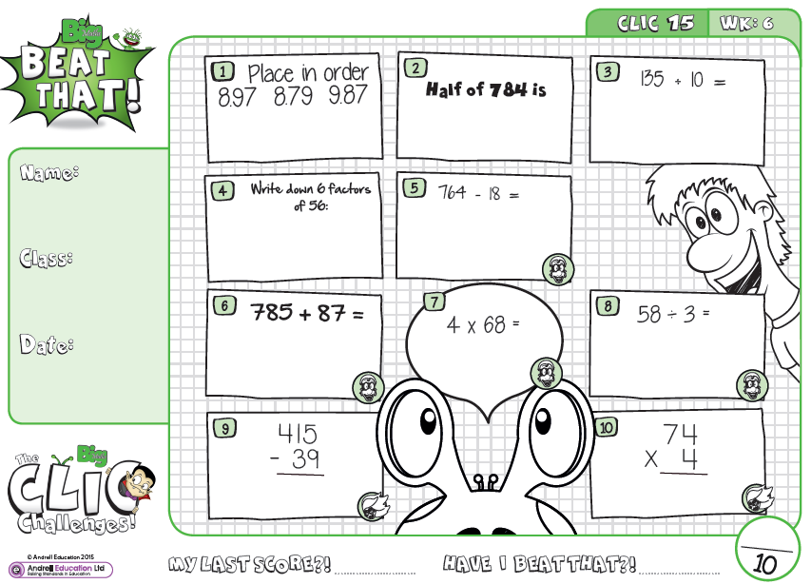
CLIC
CLIC 15 (of 20)

Slide 16
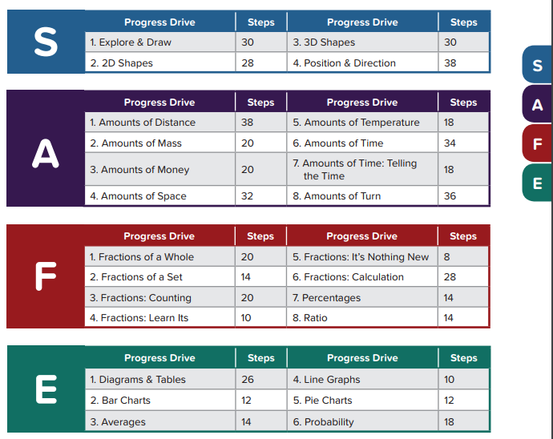
SAFE

Slide 17
How can I support my child?
Learn-Its
Times Tables
Number bonds
Help your child practise their ‘Learn Its’ at home. Introduce 1, 2 or even 3 new facts each week.
Practice
Create, download, alter, flip any numeracy questions you see.
16 ? 7 = 9
5 + ? = 12
Approx. how many people are in Asda right now?
How tall is that door?
What is the opposite of multiplication?
Encourage, support & praise
Support with homework using the examples given by the teacher. Ask your child to talk through the examples and relate this to work they have been doing in class – encourage them to teach you!

Slide 18
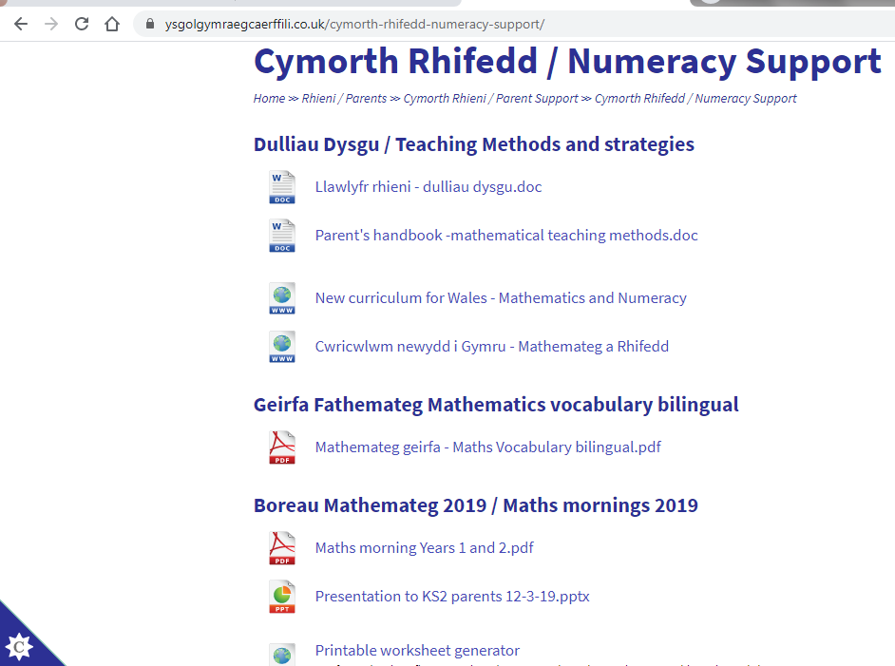
How can I find resources to support my child?
https://www.ysgolgymraegcaerffili.co.uk/cymorth-rhifedd-numeracy-support/
Parents’ handbook
Techniques, methods and procedures we use at YGC
New curriculum
Get familiar with the requirements of the new curriculum
Vocabulary
Bilingual vocabulary
Printable worksheets
Endless worksheet fun!

Slide 19
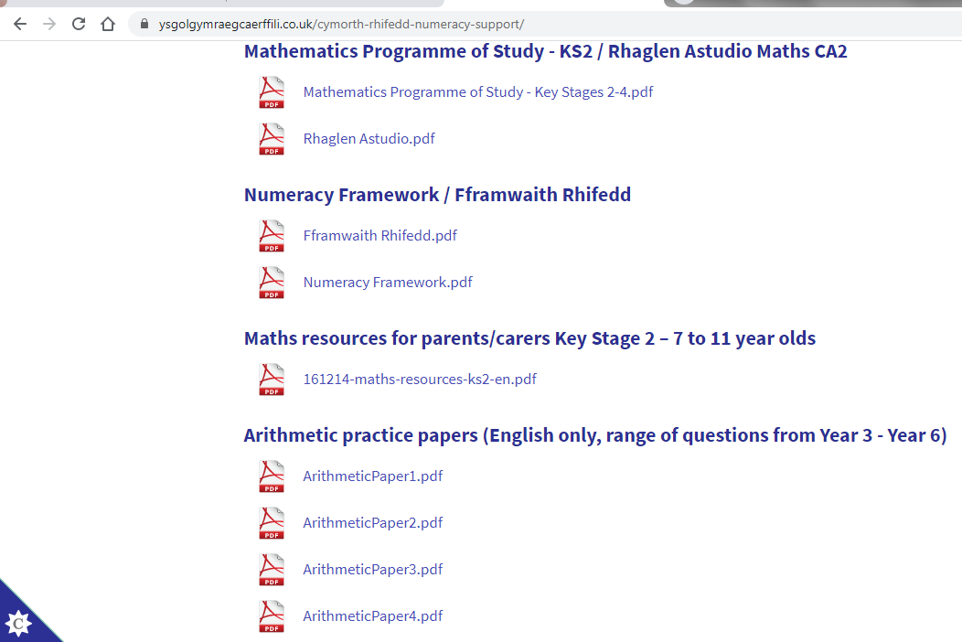
How can I find resources to support my child?
https://www.ysgolgymraegcaerffili.co.uk/cymorth-rhifedd-numeracy-support/
Programme of Study
Numeracy Framework
Maths resources
Practice papers

Slide 20
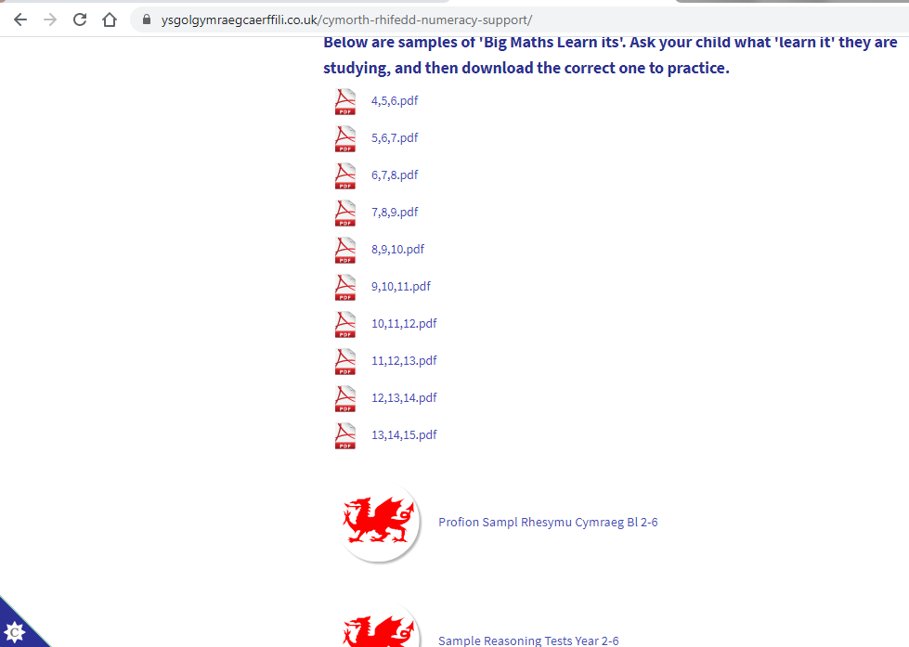
How can I find resources to support my child?
https://www.ysgolgymraegcaerffili.co.uk/cymorth-rhifedd-numeracy-support/
Sample Learn-Its
Sample Welsh Govt. Reasoning and Procedural papers

Slide 21
Any questions?

