Slide 1


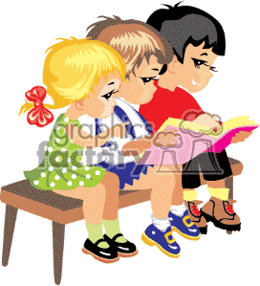

Ysgol Gymraeg Caerffili
Darllen / Reading
Helpu eich plentyn
Helping your child

Slide 2

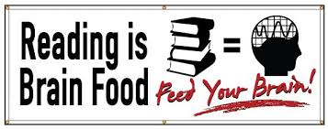
Reading opens up the door to learning and to the world. It underpins everything we do and is essential to everyday life.

Slide 3
Your role is vital!!
Parent participation is the ingredient that makes the difference!
Research shows that it’s the single most important thing you can do to help your child’s education

Slide 4


Questionnaire

Slide 5




Slide 6

Question 1:
Children who are read to every day are likely to be six months ahead with their reading when they start school.
True
False

Slide 7
Question 1:
Children who are read to every day are likely to be six months ahead with their reading when they start school.
False: they are likely to be twelve months ahead with their reading
Source: Reading to Young Children: A Head-Start in Life? G. Kalb & J.C van Ours (Melbourne Institute of Applied Economic and Social Research, 2013

Slide 8

Question 2:
Better performance in maths, vocabulary and spelling at aged sixteen is linked most strongly to which of the following?
a. Parental income
b. Parental education
c. Regular reading with a parent / carer at aged five
d. Regular reading for pleasure as a teenager

Slide 9

Question 2:
Better performance in maths, vocabulary and spelling at aged sixteen is linked most strongly to which of the following?
c. Regular reading with a parent / carer at aged five
Source: Sullivan, A & Brown, M (2013), Social Inequalities in Cognitive Scores at age 16: The Role of Reading. Centre for Longitudinal Studies, Institute of Education

Slide 10

Question 3:
At age seven, how influential is family engagement in learning compared with the quality of the school for a child’s educational attainment?
a. Family engagement has less influence than school quality
b. Family engagement has equal influence to school quality
c. Family engagement has twice as much influence as school quality
d. Family engagement has six times as much influence as school quality

Slide 11
Question 3 :
At age seven, how influential is family engagement in learning compared with the quality of the school for a child’s educational attainment?
d. Family engagement has six times as much influence as school quality
Source: Desforges and Abouchaar (2003) The impact of parental involvement, parental support and family education on pupil achievement and adjustment. Cited in FaCE the challenge together: Family and community engagement toolkit for schools in Wales

Slide 12
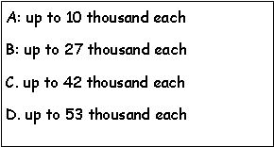

Question 4 :
According to research how much will each illiterate child cost society by the time they reach 37?

Slide 13
Question 4 :
According to research how much will each illiterate child cost society by the time they reach 37?
*

Slide 14
Research shows that how well children learn to read affects directly not only how successful they are in school but how well they do throughout their lives.
Research also shows that parental participation is the most important factor in a child’s success in learning to read and a child success in life.

Slide 15
To become ‘readers’ and to master the skill of ‘reading’ children need:
To know how books work – book handling skills
To know their letter sounds, blends and vowel digraphs (sounds represented by two letters)
To be able to read a variety of words by ‘sight’ - especially tricky words
To have a range of strategies for decoding unknown words
To read using appropriate intonation and expression
To be able to use punctuation to inform their reading and interpretation of what they are reading
To understand what they have read by using information in pictures, asking questions - discussing – good comprehension skills are essential

Slide 16
“Enjoyment of books is the most important factor when learning to read”
(Basic skills Agency 2002)

Slide 17
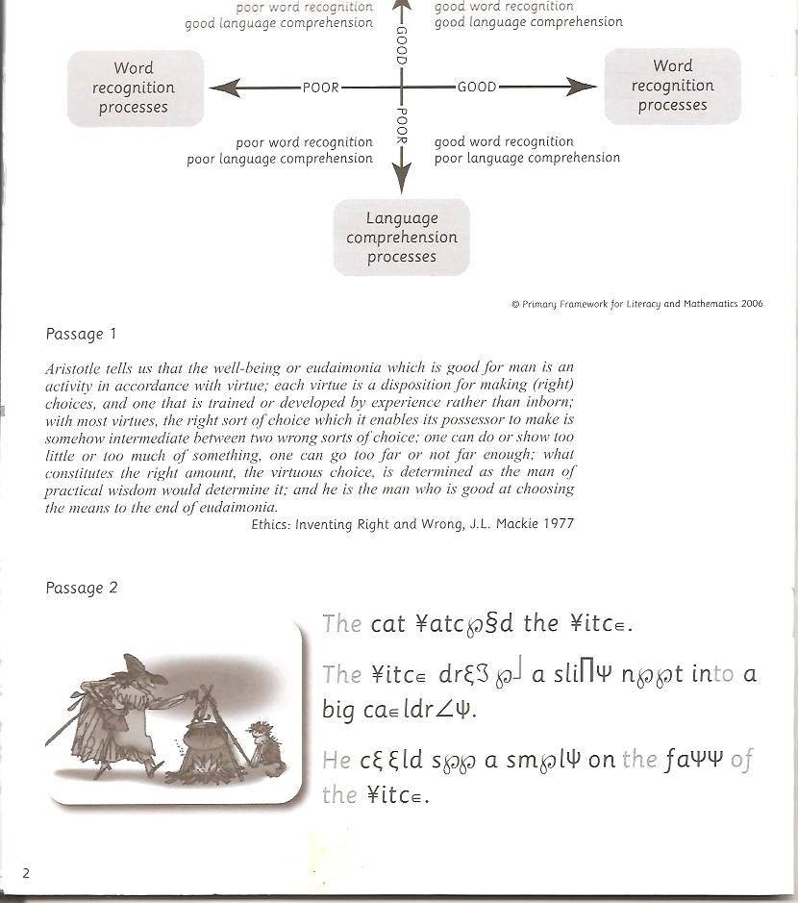
This is what children face if they don’t know all their letter sounds.

Slide 18
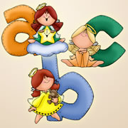

Welsh Phonics
How you can help:
Please help your child to learn letters in Welsh
The Welsh alphabet is phonetic.
The letters do not have a name and a sound.
C makes the sound C and is called C.

Slide 19






Yr Wyddor / Welsh Alphabet
A
ff
aa
ac
ad
ae
af
ag
b
ach
add
ah
ai
aj
al
all
am
ng
an
ap
ar
ao
aph
rh
as
at
au
aw
ay
ath
**There are eight double letters - these have a single sound

Slide 20
The following letters have the same sounds as in English:
ab
ah
aj
at
al
am
aff
Ap
ph
d
a
a
a
a
For the pronunciation of other letters see information sheet provided
a
a
a

Slide 21


The double letters:
Ap
am
a
a
a
ch
a
as Scottish ‘CH’ (loch)
a
a
a
We teach the children to clear their throats!
a
a
a
a
ff
a
as in Ffion
a
a
It’s a long sound, we teach the children to pretend to pull a long string out of their mouths by saying ff with out stopping.

Slide 22

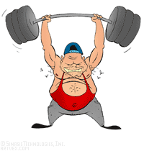
The double letters:
Ap
am
a
a
a
dd
a
voiced as ‘ in English ‘this’
a
a
a
We teach the children to make the noise of a pneumatic drill! (ddoi di i ddawnsio)
a
a
a
a
ng
a
as in king
a
a
We teach the children to pretend they are lifting a heavy weight saying ‘ng’ as they do so

Slide 23


The double letters:
Ap
am
a
a
a
ll
a
as in ‘Llanelli’
a
a
a
We teach the children to widen their mouths to say ‘ll’
a
a
a
a
ph
a
as in Philip
a
a
We teach the children to pretend to blow a balloon or bubbles in the air.

Slide 24
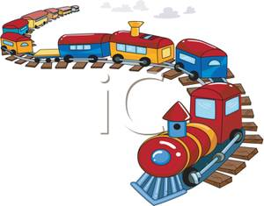

The double letters:
Ap
am
a
a
a
rh
a
as in Rhodri
a
a
a
We teach the children to pretend to be a moving train, making the sound, rh, rh, rh getting gradually faster
a
a
a
a
th
a
a
As in Thelma and always as ‘th’ (both)
a
We teach the children to put their hands in front of their mouths – they must be able to feel their breath on their hand.

Slide 25
Digraphs
si
aw
oe oi
wy
ei eu
ae ai
au
iw yw uw

Slide 26
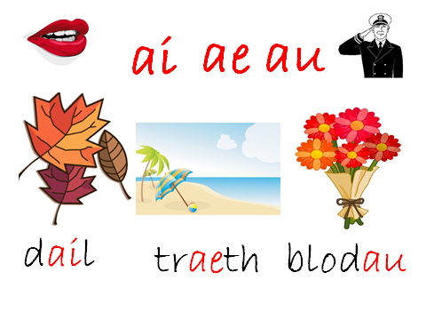

Slide 27
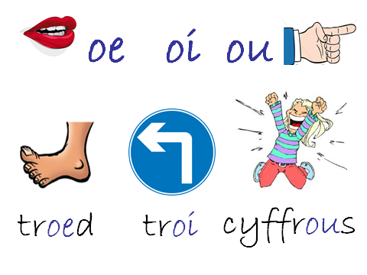

Slide 28
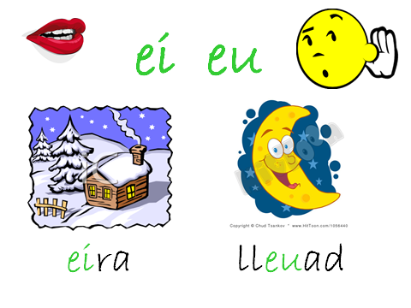

Slide 29
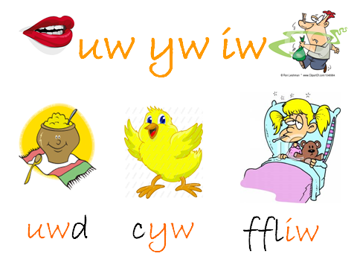

Slide 30
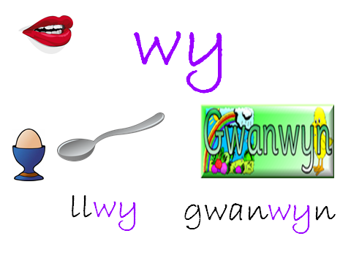

Slide 31
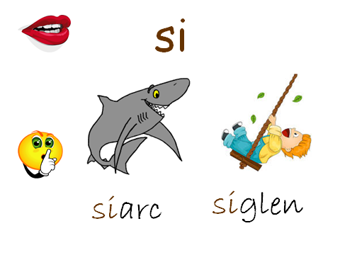

Slide 32


Slide 33


si

Slide 34

oi oe ou

Slide 35


ei eu
wy

Slide 36

ae
ai au
Oi oewy

Slide 37

iw
yw uw
Oi oewy

Slide 38

wy

Slide 39
ae
ai au
Oi oewy

Slide 40
si

Slide 41
wy

Slide 42
oi oe ou

Slide 43
ei eu
wy

Slide 44
oi oe ou

Slide 45
iw
yw uw
Oi oewy

Slide 46

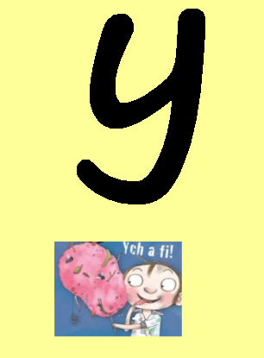
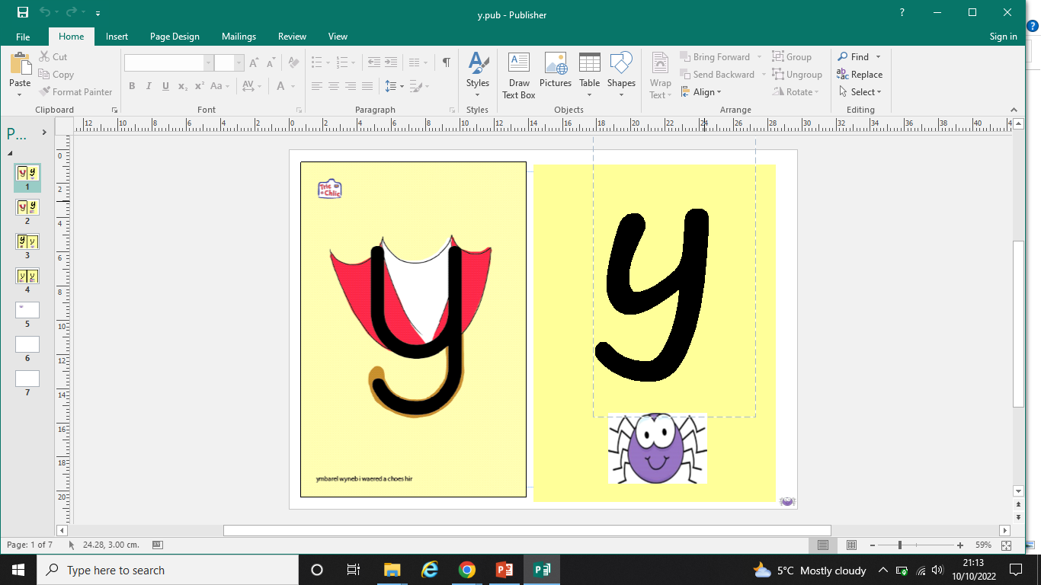
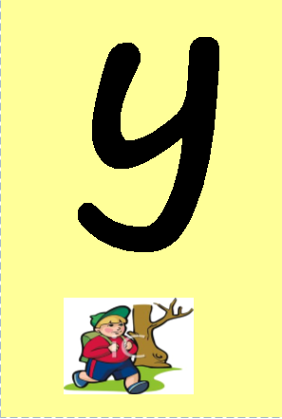
Tricky letters!

Slide 47
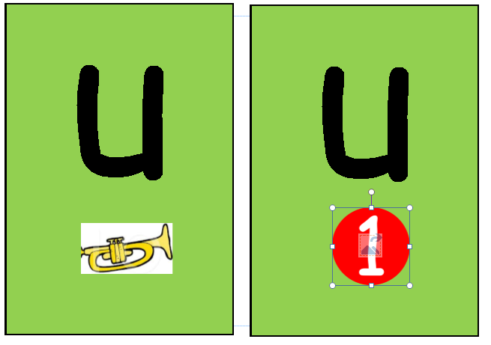
Tricky letters!

Slide 48
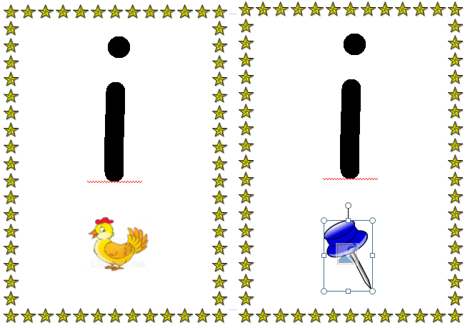
Tricky letters!

Slide 49
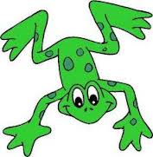


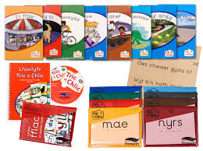
Blending
c a th
Look for the special friends!

Slide 50

Blending in Welsh……. Look for the special friends!
eisiau
ei si au
Speedy Readers!!!!!
This skill will only improve with lots and lots of practice!

Slide 51
Blending in Welsh…….
ffrwythau
ff wy th
r
au
.
This skill will only improve with lots and lots of practice!

Slide 52
Break the word into chunks
edrychodd
ed rych odd

Slide 53


Segmenting - spelling
bath

Slide 54

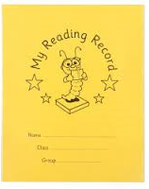
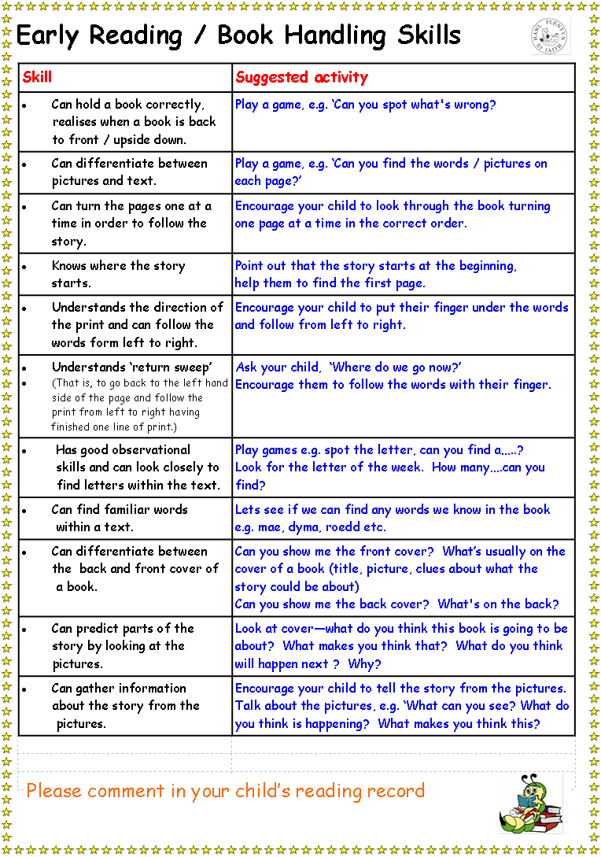
How you can help:
School Reading Record
*Rhan Catrin - wedi addasu*

Slide 55
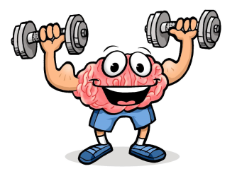
Please encourage your child to read for 10 - 15 minutes on a daily basis. Independently and with an adult!
They must bring their file every day!
Pupils are rewarded daily for reading at home!
Please comment, sign or both, this is expected every night please! This is how we monitor how much your child is reading.

Slide 56



There is a wealth of research supporting daily 10-15 minutes of reading with your child especially prior to and during the period when s/he is learning to read.

Slide 57

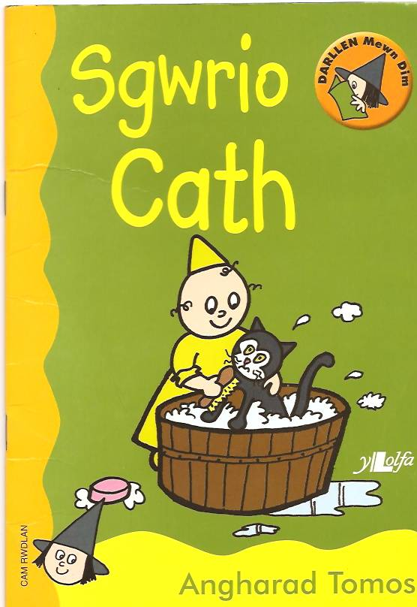


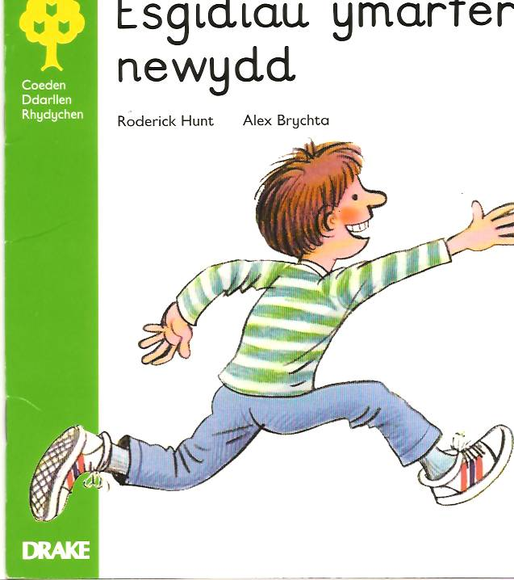
Reading books

Slide 58



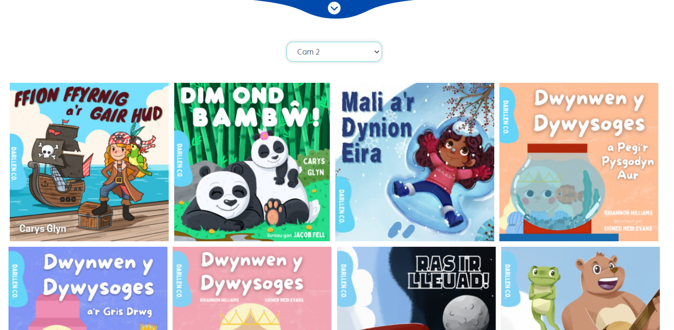
Darllen Co

Slide 59

Questions you can ask......

Slide 60
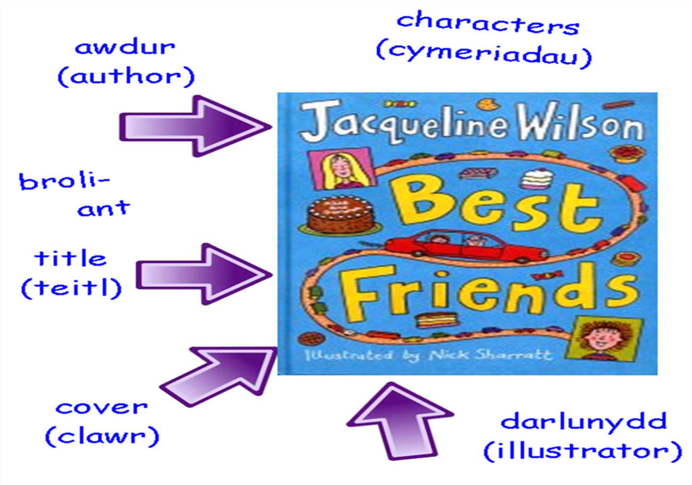
Before reading…….
* Book cover - What is it about?
* Blurb - What do we know after reading the blurb?
* Title of the book - Can you show me where the title is?

Slide 61
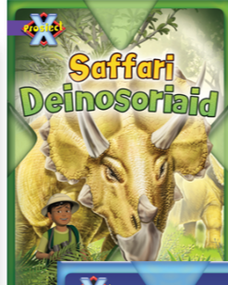
Who is the author of the book?
Who is the illustrator of the book?
How do you know?
Explain…
Is it a story or an information book?
What is an illustrator?

Slide 62



Whilst reading …….
What does that sentence/paragraph tell you?
What has happened so far in the story?
What do you know now after reading this page?
What do you think’s going to happen now?
Can you tell me anything about the characters?
Which is your favourite character? Why?

Slide 63




Reading with expression
Punctuation Kung Fu

Slide 64

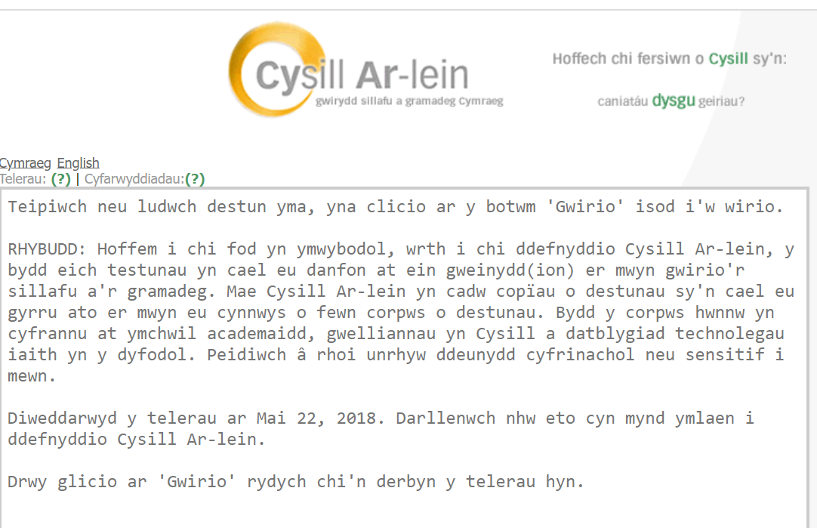
Cysill Ar-lein / Cysill Online
Ap Geiriaduron / Dictionary App

Slide 65
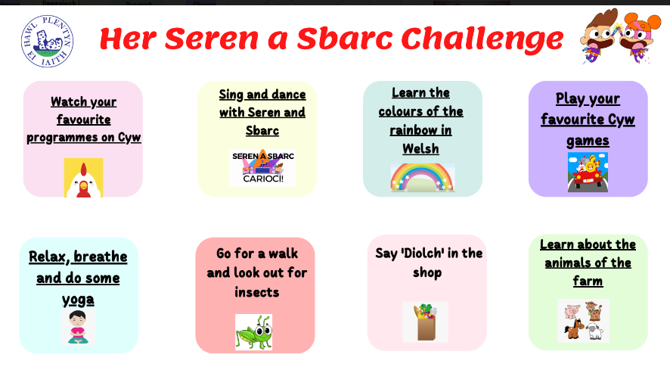
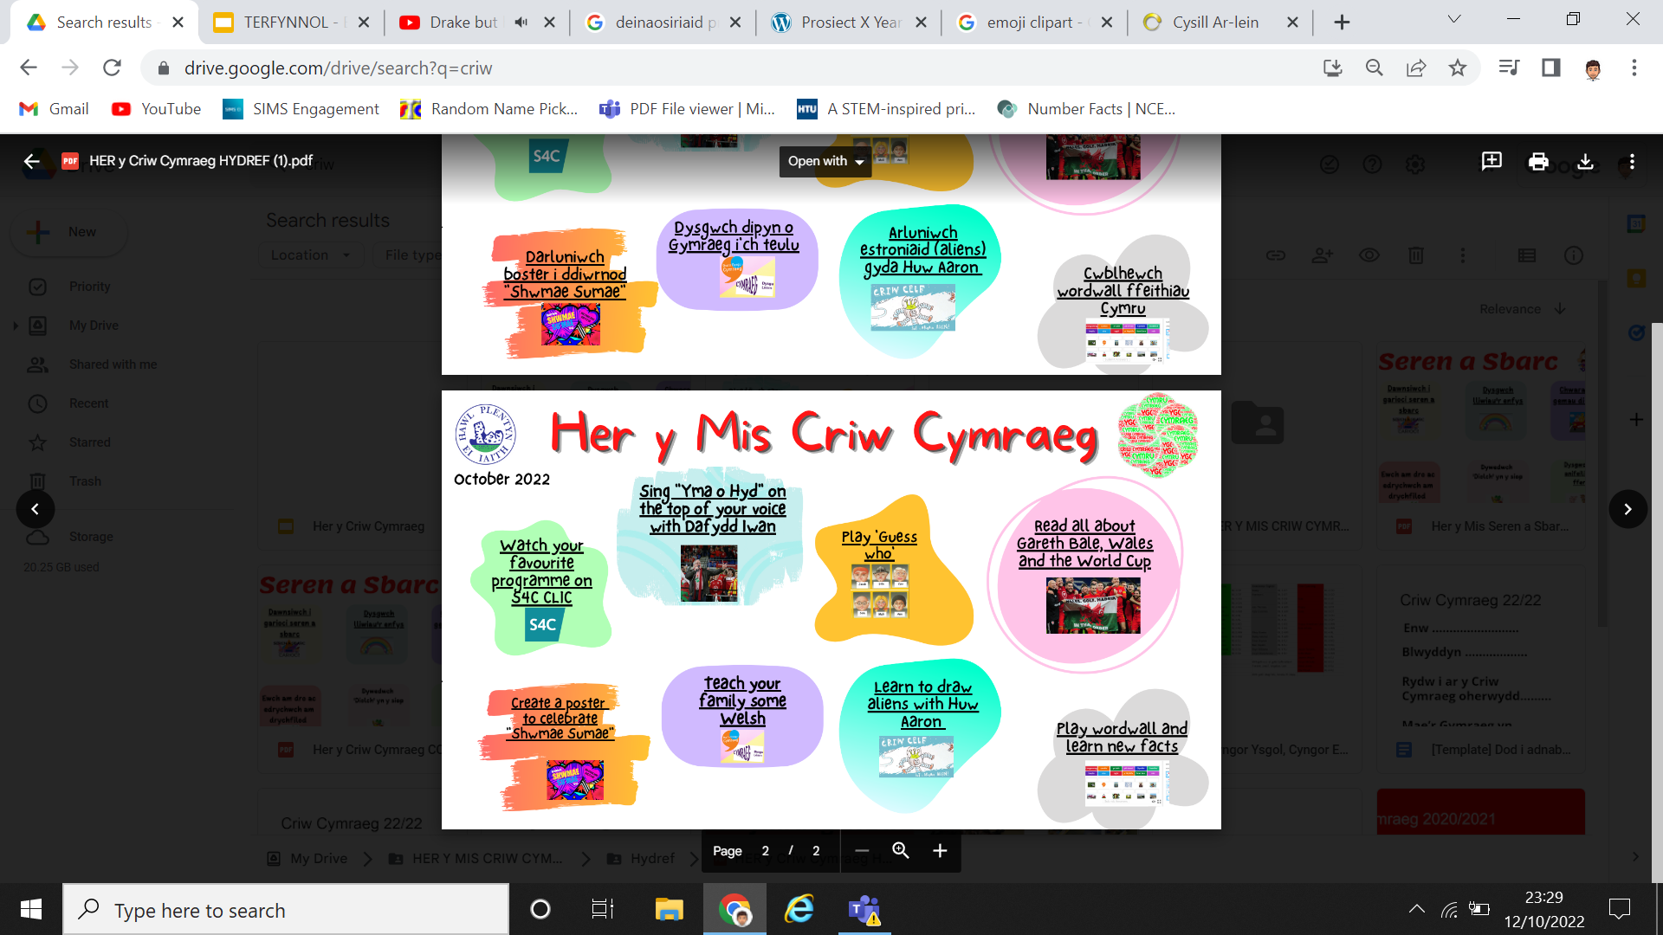
Engaging at home - Challenge of the month

Slide 66
Group Guided Reading
Group / Guided reading takes place every day between 9 – 9.30 9 am start!! (Handwriting practice starts at 8.45)
All children read with staff during group reading at least twice a week
In most classes children read on an individual basis to an adult – we need more volunteers!
Language lessons concentrate on developing the skills we have referred to today as well as oracy and writing skills

Slide 67
Any Questions??

Slide 68
Please fill in and return questionnaire
Thank you for your time and support!

Slide 69

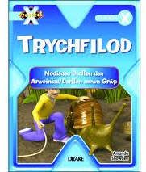
Group Guided Reading
Factual Book / Fiction Book?

Slide 70
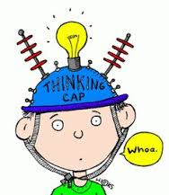
Group Guided Reading
What have you learnt about……………?
What has happened so far……….?
Tell your Partner……..
In your own words……
Summarize what’s happened
so far
Where does it tell us…find it prove it!!!
New words and vocabulary

Slide 71
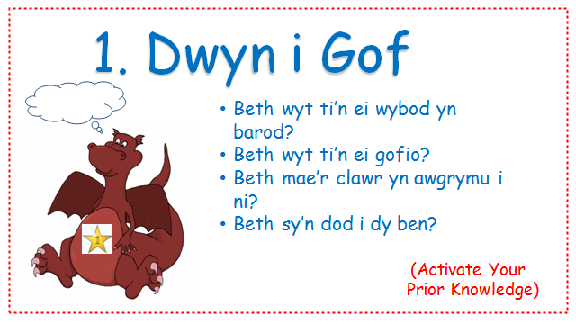
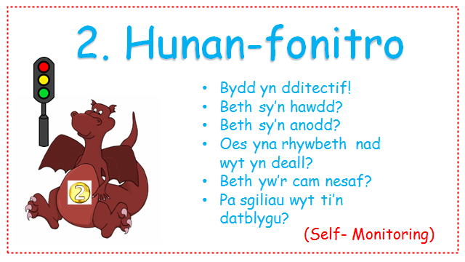
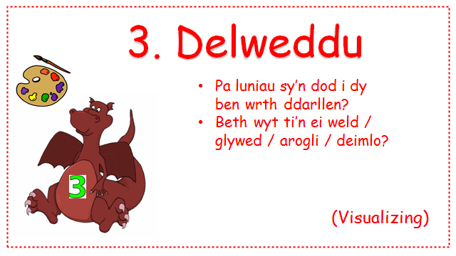
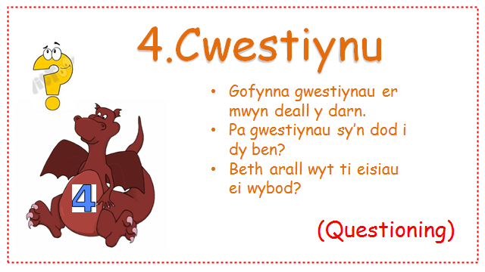

Slide 72
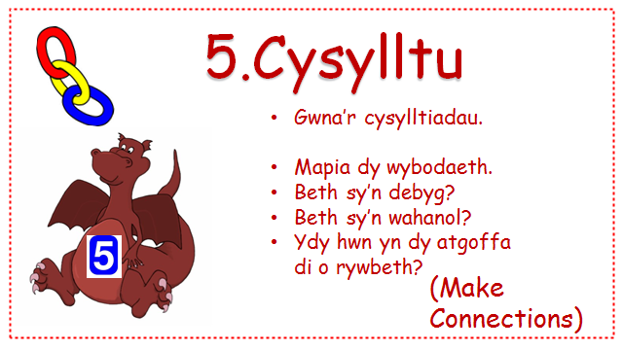
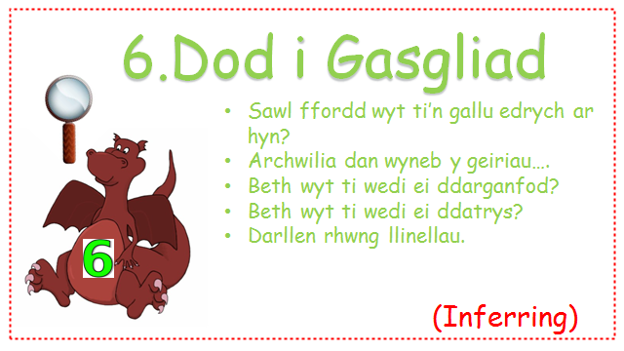
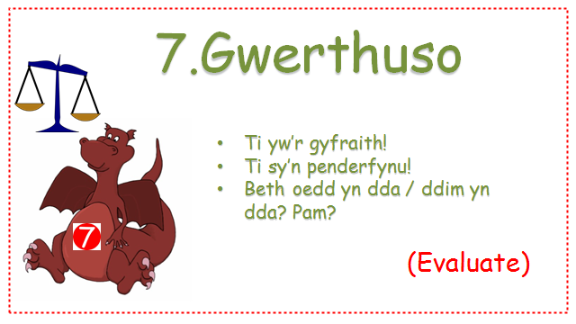
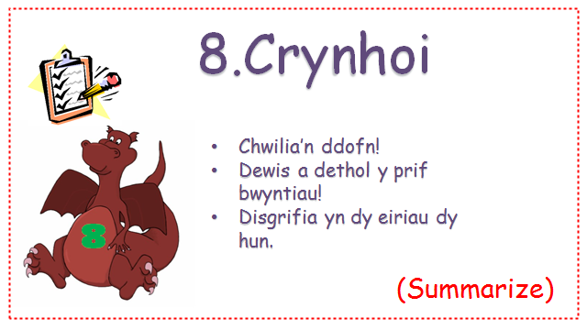

Slide 73
Higher Order Reading Skills
Once children have a good knowledge of phonics and word building we move on to develop higher order reading skills. These are:
Inference
Deduction
Authorial technique and intent
Skimming and scanning
(These are taught to children right from the start of their reading journey, discussion centres around the pictures, events etc but when decoding becomes less of a problem then the aim is to teach the children to become more analytical about the text itself and their response to it)

Slide 74
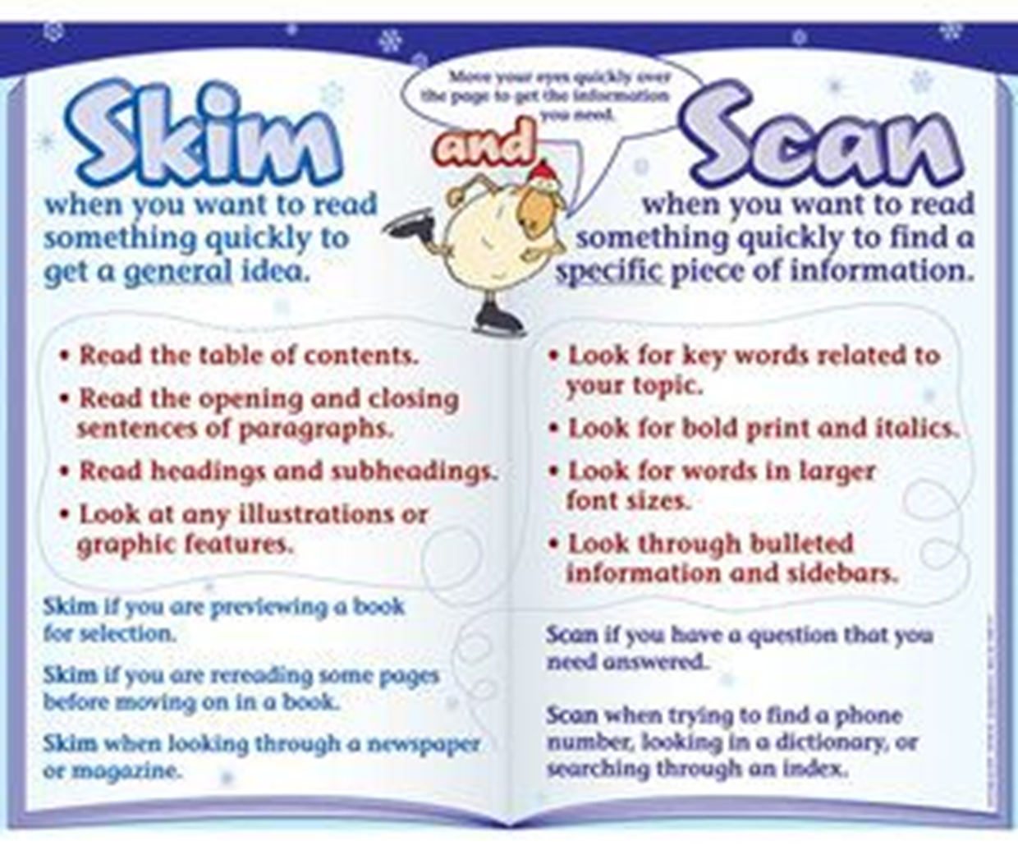
Group Guided Reading
Skimming and Scanning

Slide 75
Higher Order Reading Skills
Skimming:
To gain an overall impression.
Skimming is often used if you want to see if an article in the newspaper is of interest to you.
Scanning:
To locate information quickly.
Usually when reading non-fiction, it’s often useful to scan pages quickly to look for a particular piece of information.
Scanning is technique often used when looking up a word in the dictionary.

Slide 76
Group Guided Reading
Skimming and Scanning

