Slide 1
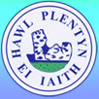
Ysgol Gymraeg Caerffili
Cyflwyniad i rieni // Presentation for parents.
Dafydd Leigh - ICT, Science & STEM Coordinator

Slide 2
Our vision
Our aim at Ysgol Gymraeg Caerffili is to provide a high-quality computing education enabling pupils to use computational thinking and creativity to understand and change the world.
By encouraging the use of technology in lessons, as outlined in the Digital Competence Framework (DCF), we aim to use a range of different technology to give pupils a wealth of experience in digital competence.

Slide 3
Where are we now?
Computer suite
PCs in every class
iPads - 10 in every KS2 class, 8 in FPh
Chromebooks - 64
iPod touch - 16 in year 6
· 96.39% use ICT daily within school
· 96.4% are confident using ICT and are aware of the importance of e-safety

Slide 4
Our standards
June 2018 - learning walk
ICT lesson observations noted particular strengths in:·
Lesson plans indicate careful planning against Digital Competence Framework (DCF)
Planning also showed links to IT curriculum and LNF
Confidence of learners evident at every age level
Creative use of interactive whiteboards including SMART Notebook s/w
Extensive use of outdoors working areas

Slide 5
Vision and focus
Ensure ICT is implemented across the curriculum (DCF) as per Donaldson recommendations.
Ensure pupils are confident in working collaboratively
Continue educating pupils regarding e-safety – ongoing but all KS2 classes to focus on e-safety in first fortnight, once a term and during Safer Internet day week.
Increased coding opportunities in a range of languages especially with Microbits, Edison Robots, Drones, Lego Wedo
Widespread use of google drive within classroom and for homework especially in upper KS2.
Provide appropriate challenges for pupils to maintain interest and stretch MAT pupils.
Innovative use of Virtual Reality Headsets.

Slide 6
Digital Competence Framework
Is one of the 3 cross-curricular responsibilities
Focuses on developing skills which can be applied to a wide range of subjects and scenarios
4 strands of equal importance – Citizenship, Interacting and Collaborating, Producing, and Data and Computational Thinking.
Within each strand, there are a number of elements that children should experience

Slide 7
Citizenship | Interacting and Collaborating | Producing | Data and Computational Thinking
Identity, Image and Reputation Health and Well-being Digital rights, licensing and ownership Online behaviour and cyberbullying | Communication Collaboration Storing and sharing | Planning, sourcing and searching Creating Evaluating and improving | Problem solving and modelling Data and information literacy

Slide 8
Why is this so important?
Recent studies indicate that 90% of future jobs that our pupils will be undertaking will involve the use of ICT.
Therefore it is our responsibility to prepare our pupils, and ensure our pupils have the skills needed to be employable and creative for the future.

Slide 9
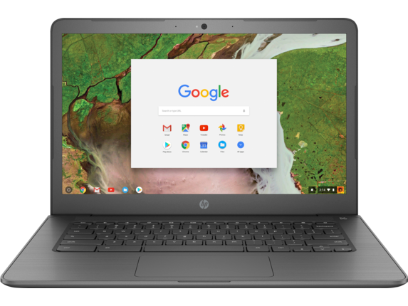
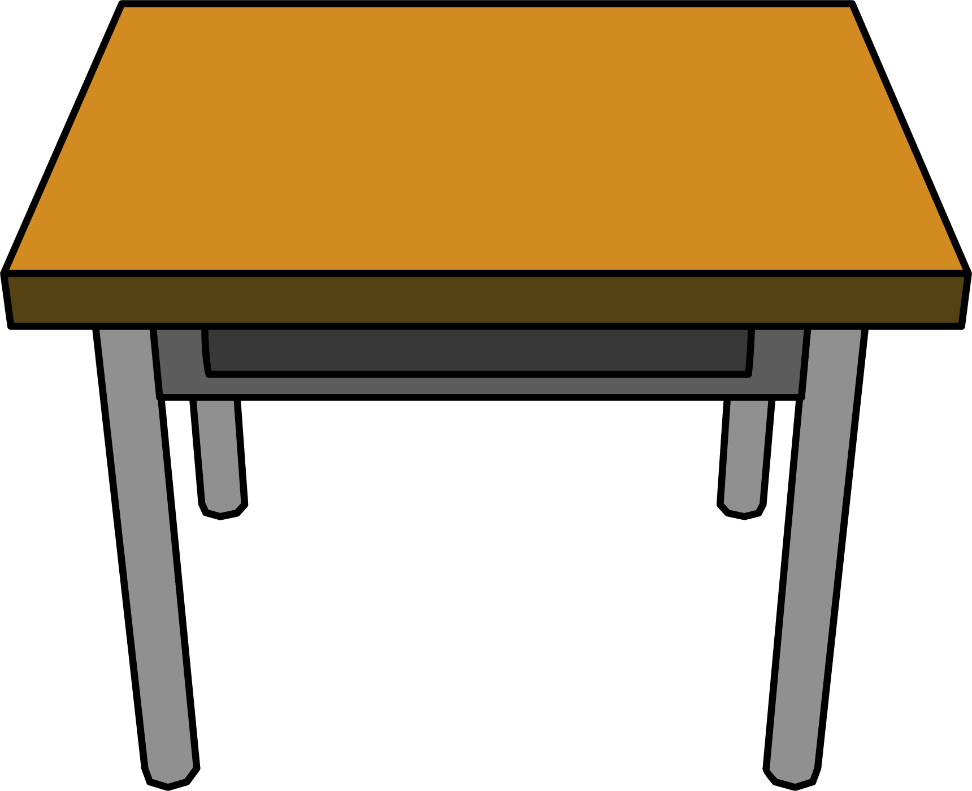





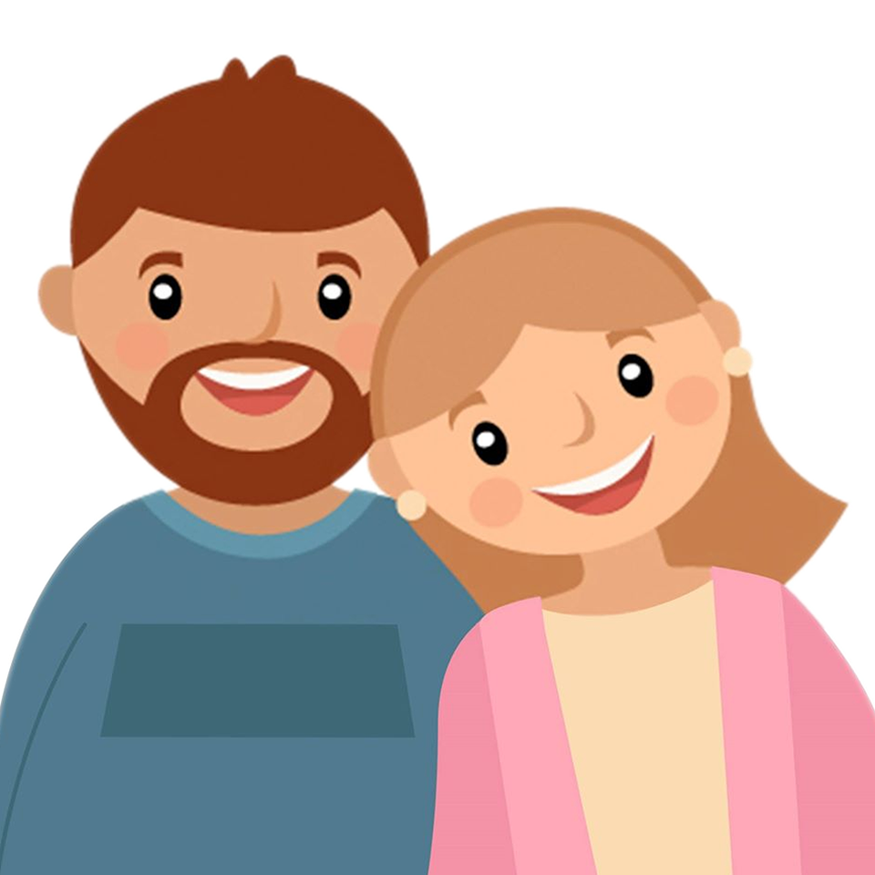


Digital Leaders
Notes:
During our session to school parents, we will be focussing on the use of the Google Apps.
We will split to 3 groups, with each group focussing on a different app.
Docs, Slides and Drive.
Hopefully by the end of the session, parents will have a better understanding of these apps, and how Drive can be used as the hub for these apps.

Slide 10
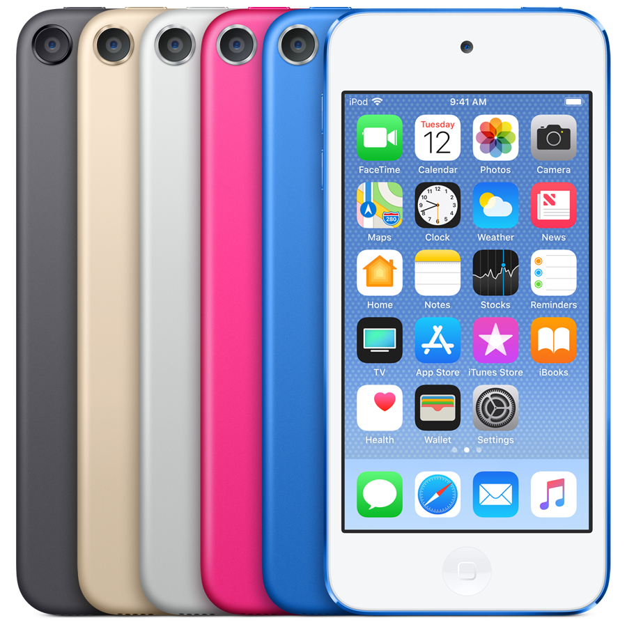
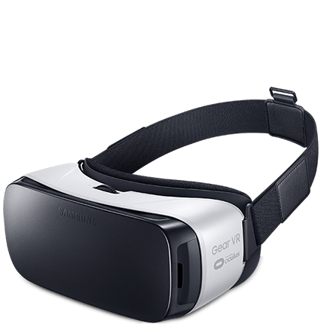


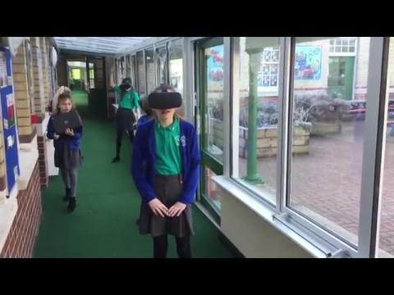

Innovation / Sector Leading
Notes:
We have invested in new technology this year.
iPod touches: We have 16 to share between year 6 classes. These will mainly be used during group reading in the morning to listen to Welsh language podcasts. This links to our Siarter Iaith targets. We have a range of BBC Cymru podcasts, ranging from football to nature.
VR headsets: Virtual Reality excites us, and engages us. Here are our 2 main uses; Practice public speaking in front of an audience using SpeechVR to improve our oracy skills. We will also be using Google Expeditions and Discovery VR as a starting point for creative writing.
Sketchup: This CAD (computer aided design) software is free, and we are using it to design objects and ideas in 3d. Once created, objects can be scaled to size and exported as an STL file ready to 3d print. There may be a possibility to 3d print our creations and sell them to our pupils in the future. Here is an example of a name tag I have designed, which we would be able to sell to pupils for their school bags.

