Slide 1


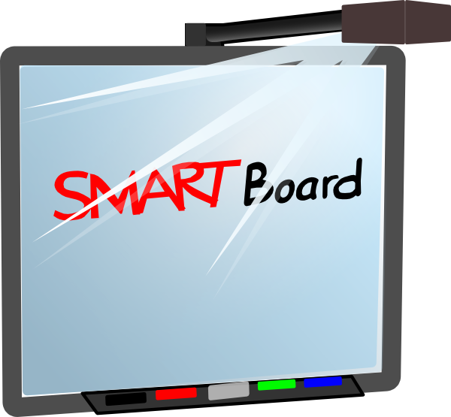


Bore TGCh
ICT Morning

Slide 2
Objectives
Discuss the importance of technology
The Digital Competence Framework and its benefits
Technology in the Foundation Phase
E-Safety
Stations set up with different technologies for you to experience

Slide 3

Technology
Constantly evolving
Drastically changed the way we live and learn
Technology has created amazing tools and resources that puts useful information at our fingertips
Has made our lives easier, faster and more fun
Future technology is even more interesting and exciting

Slide 4
Digital Competence Framework
Recognises that digital competence is fundamental to learning so that children can participate confidently and successfully in the modern world
Preparing children for their future careers
21st century learners who are creative, ambitious, problem solvers, healthy and confident

Slide 5
Benefits
Engages children
Enhances their learning experience
Encourages responsibility and allows them to take ownership of their learning
Provides children with new and exciting opportunities
Enables children to learn to their best ability – visual, physical or audio
Camouflages learning (learning through play)

Slide 6
Digital Competence Framework
Is one of the 3 cross-curricular responsibilities
Focuses on developing skills which can be applied to a wide range of subjects and scenarios
4 strands of equal importance – Citizenship, Interacting and Collaborating, Producing, and Data and Computational Thinking.
Within each strand, there are a number of elements that children should experience

Slide 7
Citizenship | Interacting and Collaborating | Producing | Data and Computational Thinking
Identity, Image and Reputation Health and Well-being Digital rights, licensing and ownership Online behaviour and cyberbullying | Communication Collaboration Storing and sharing | Planning, sourcing and searching Creating Evaluating and improving | Problem solving and modelling Data and information literacy

Slide 8
Technology in the Foundation Phase
Is holistic and integral across the curriculum
Their ICT skills, knowledge and understanding are developed through a range of experiences
Children are given opportunities to develop these skills using a wide range of equipment and software's.

Slide 9
Types of Technology
iPods
Chromebooks
BeeBots
Hairdryer
IWB
iPads
Metal Detectors
Walkie Talkies
Voice Pegs
VR Headsets
Phones
Computers
Torches
Green Screen
CD Players
Stopwatches
Cameras
Calculators

Slide 10
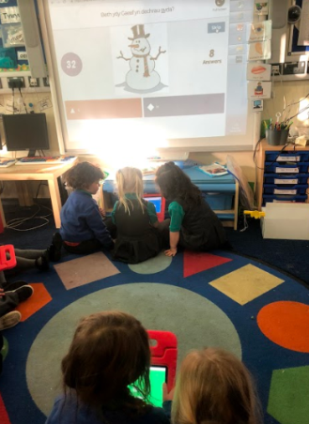
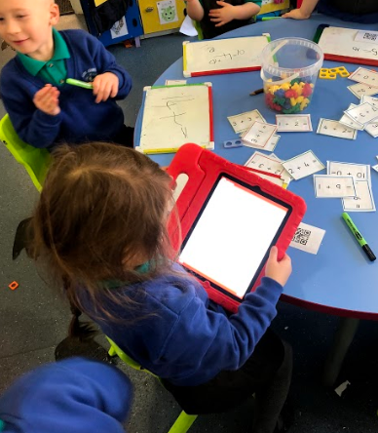
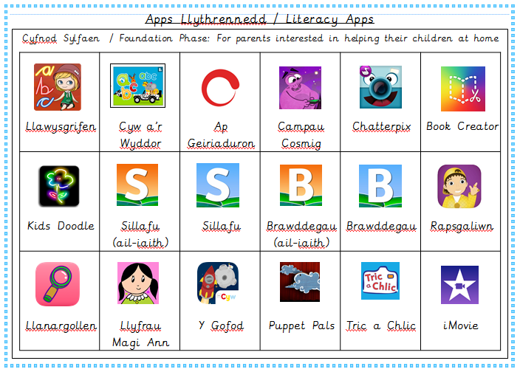
iPads – Literacy
List of apps that we use for literacy will be provided
Children are able to take pictures, record videos, watch videos, draw pictures, listen to songs and record using green screen
Practise letter formation / recognition, spelling, sentence structures, imagination, retelling stories, creating their own stories.

Slide 11
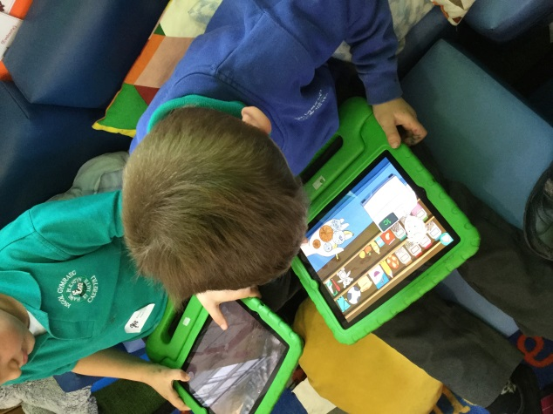
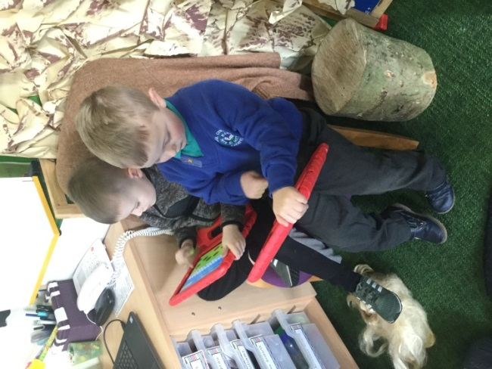
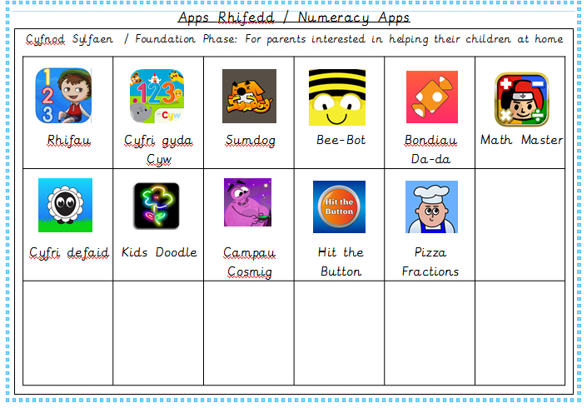
iPads – Numeracy
List of apps that we use for numeracy will be provided
Children are able to use the calculator, practise number formation and recognition, practise counting, practise basic mathematical skills, go on shape hunts and take pictures.

Slide 12
iPads - Things that you can do at home
Use the apps on the sheets provided
Nursery/Reception – practise formation using KidsDoodle, Cyw/Tric a Chlic, learn new words using ap geiriaduron
Year 1 – practise formation, develop mathematical skills on Sumdog, practise spelling + sentence structure on Campau Cosmig
Year 2 – create your own videos/books with iMovie and Book Creator.

Slide 13
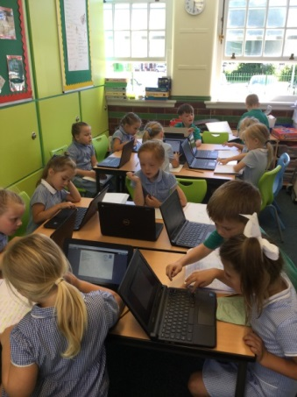
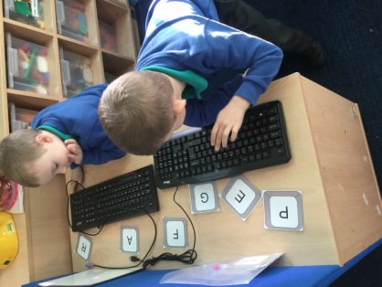
Computers / Chromebooks – Literacy
Keyboard – letter recognition
PurpleMash and 2Simple
Improves their hand/eye coordination
Practise letter formation using paint

Slide 14
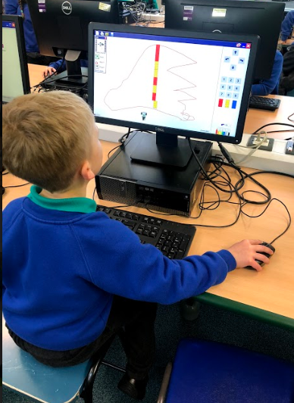
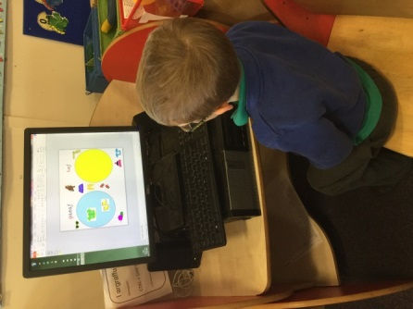
Computers / Chromebooks – Numeracy
Keyboard - number recognition
Sumdog
2Simple + PurpleMash – collect data, sort objects, pictogram

Slide 15
Things you can do at home
Practise turning the computer on and off
Practise using a mouse
Develop understanding of a keyboard (space etc)
Saving their work
Ownership of their work
Can access Sumdog and Purple Mash at home

Slide 16
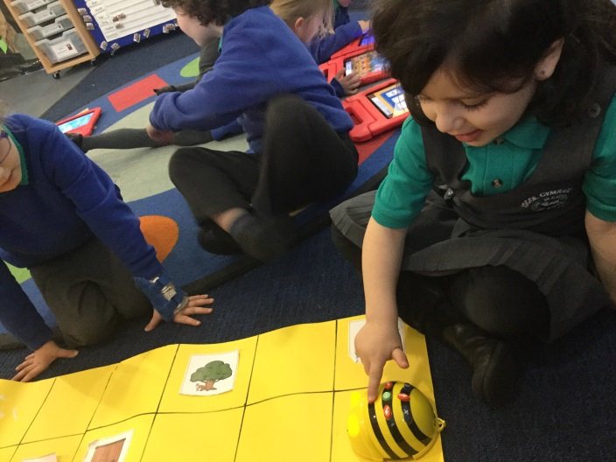
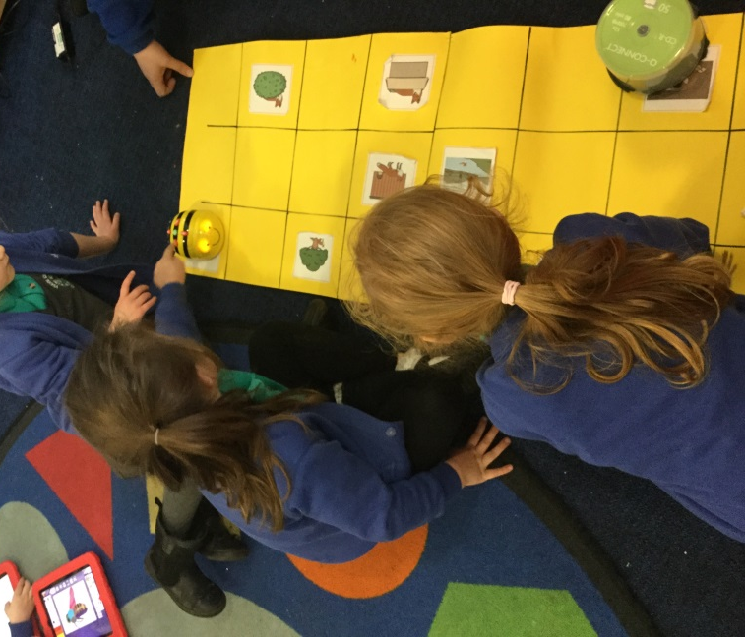
Beebot
Teaches children the fundamentals of computational thinking
Develops their understanding of sequencing, coordinates, distance and location
Allows children to create, explore and problem solve to achieve success
Can be used to develop literacy and numeracy skills

Slide 17
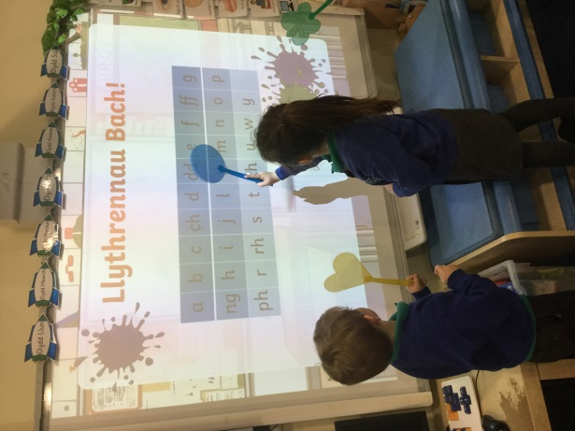
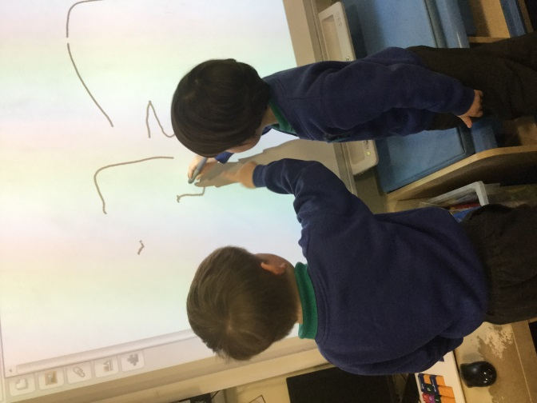
IWB
Good for gross motor skills for eyfs children
Literacy – practise letter formation/recognition, spelling, drawing story maps, crosswords,
Numeracy – number recognition/formation, write sums, sort objects, order numbers.

Slide 18
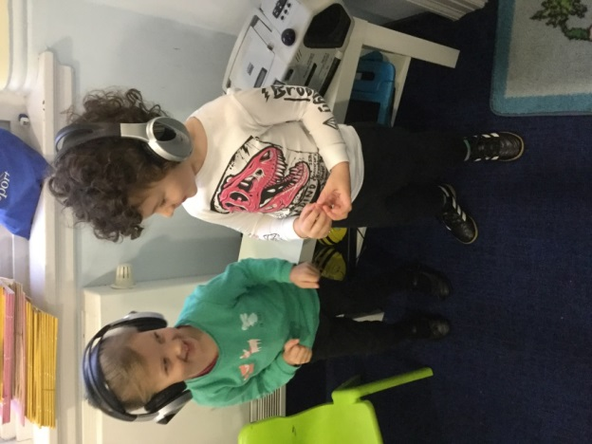
CD / Stereo
Develop their listening and understanding skills
Develop Welsh Language through listening to songs and stories
Listen to songs that help develop their maths such as counting

Slide 19
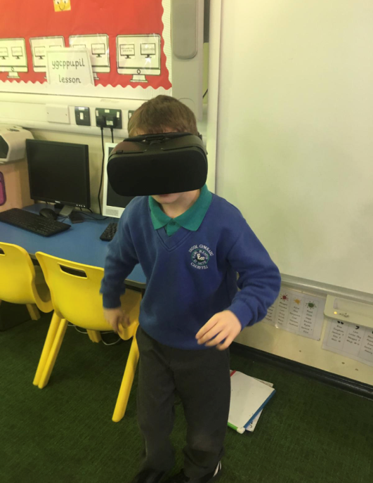
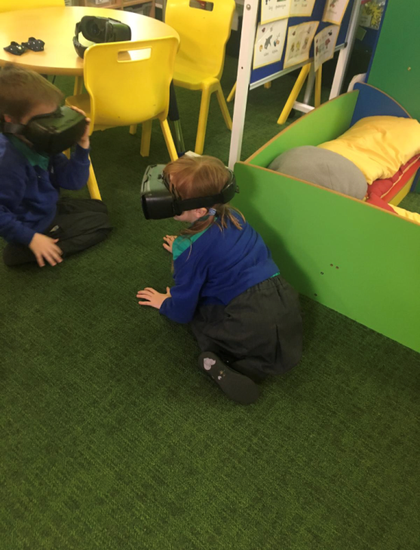
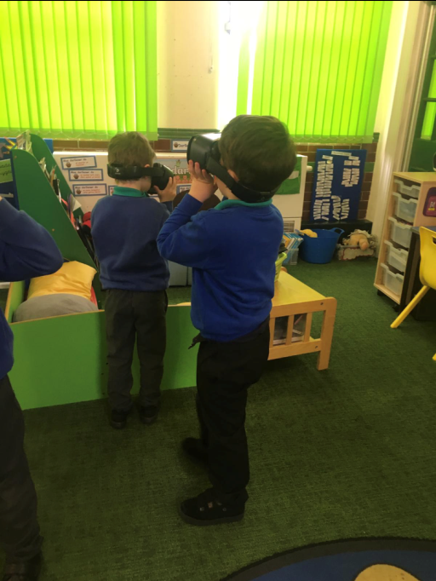
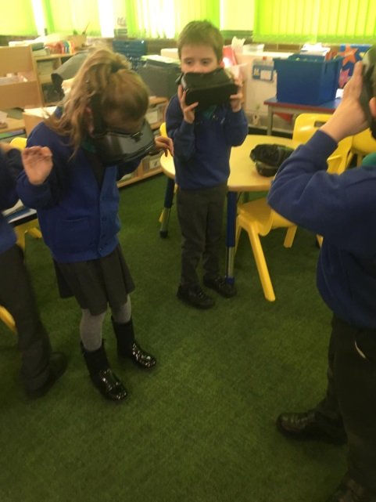
VR Headsets
Develops their imagination
Are able to experience different scenarios in order to improve the quality of their writing

Slide 20
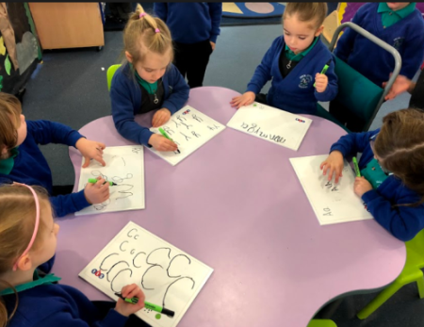
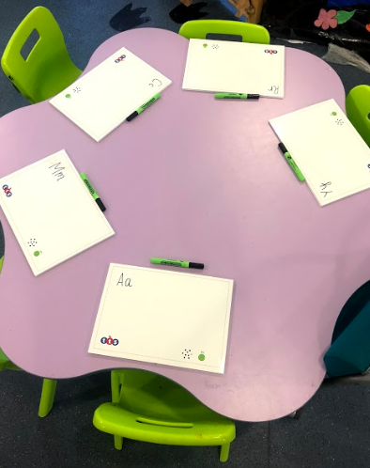
Voice Pegs / Recordings
Develop listening skills
Continuous Provision - encourages independence
Enables children to follow instructions
Spelling – hear a word and they use ‘Bili Bysedd’ to spell
Maths – practise number formation, addition/subtraction
Can record their own messages

Slide 21
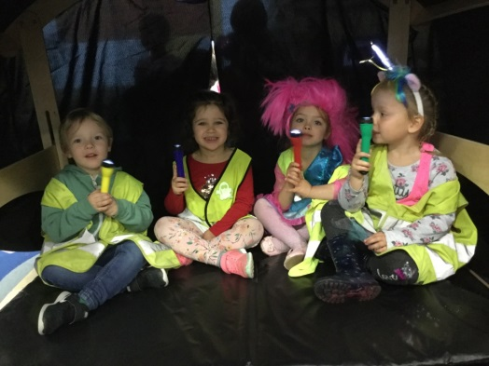
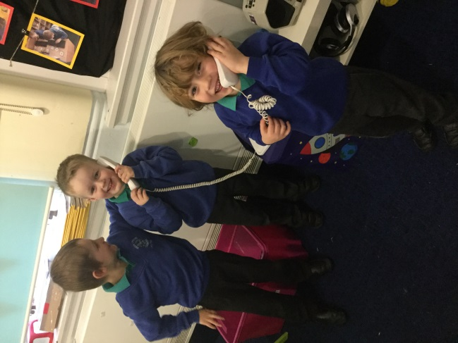
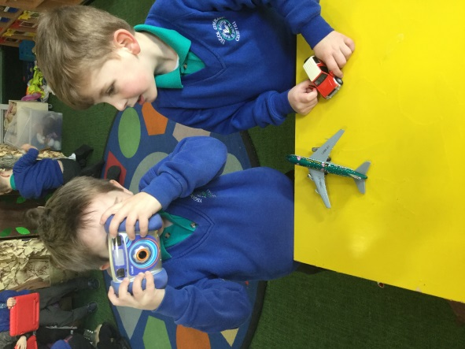
Other technologies
Torches
Walkie talkies
Light up boxes
Mark making boards
Metal detectors
Calculators
Stop watches
When used in a creative way, these technologies engage and excite children, therefore developing their concentration and skills.

Slide 22
E-safety
Help your children to understand that you can’t talk to strangers online
Apps – xbox and playstation have an app you download to your phone (can monitor who your child speaks to)
Locks on ipads – general, accessibility > guided access > on > passcode settings > set guided access passcode

Slide 23

Mindfullness app – Breathe Kids
Different missions – quiet, focus, caring & connecting, energizing, meltdown, open mind and sleep options
Helps children develop skills and improve their focus
Children are able to concentrate better and feel happier and more relaxed.

Slide 24
The fun part
iPad Station
Green Screen Station
Chromebook Station
Beebot Station
VR Headset Station
CD Player + Voice Peg Station

